Slide 1
Random Sampling on Big Data: Techniques and Applications
Ke Yi
Hong Kong University of Science and Technology
yike@ust.hk

Slide 2


Slide 3

“Big Data” in one slide
The 3 V’s:
Volume
  External memory algorithms
  Distributed data
Velocity
  Streaming data
Variety
  Integers, real numbers
  Points in a multi-dimensional space
  Records in relational database
  Graph-structured data

Slide 4
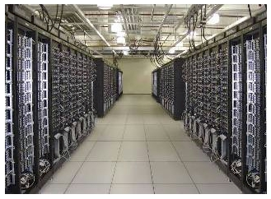
Dealing with Big Data
The first approach: scale up / out the computation
Many great technical innovations:
  Distributed/parallel systems
    MapReduce, Pregel, Dremel, Spark…
  New computational models
    BSP, MPC, …
  Dan Suciu’s tutorial tomorrow!
  My BeyondMR talk of Friday
This talk is not about this approach!

Slide 5
Downsizing data
A second approach to computational scalability:
scale down the data!
  Too much redundancy in big data anyway
  100% accuracy is often not needed
  What we finally want is small: human readable analysis / decisions
  Examples: samples, sketches, histograms, various transforms
    See tutorial by Graham Cormode for other data summaries
Complementary to the first approach
  Can scale out computation and scale down data at the same time
  Algorithms need to work under new system architectures
    Good old RAM model no longer applies

Slide 6
Outline of the talk
Stream sampling
Importance sampling
Merge-reduce sampling
Sampling for Approximate Query Processing
  Sampling from one table
  Sampling from multiple tables (joins)

Slide 7
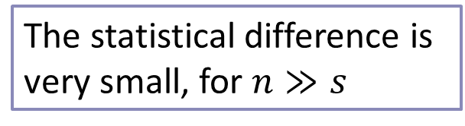
Simple Random Sampling
Sampling without replacement
  Randomly draw an element
  Don’t put it back
  Repeat s times
Sampling with replacement
  Randomly draw an element
  Put it back
  Repeat s times
Trivial in the RAM model
The statistical difference is very small, for $n≫s$

Slide 8
Stream Sampling
P
Memory

Slide 9


Slide 10
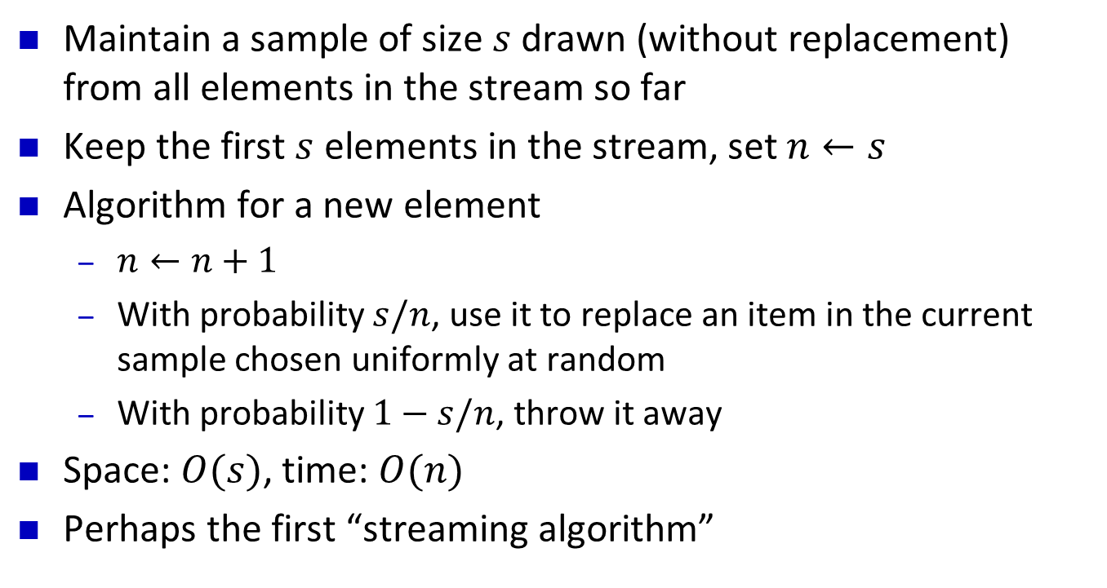
Reservoir Sampling
Maintain a sample of size $s$ drawn (without replacement) from all elements in the stream so far
Keep the first $s$ elements in the stream, set $n←s$
Algorithm for a new element
  $n←n+1$
  With probability $s/n$, use it to replace an item in the current sample chosen uniformly at random
  With probability $1−s/n$, throw it away
Space: $O(s)$, time: $O(n)$
Perhaps the first “streaming algorithm”
[Waterman ??; Knuth’s book]

Slide 11
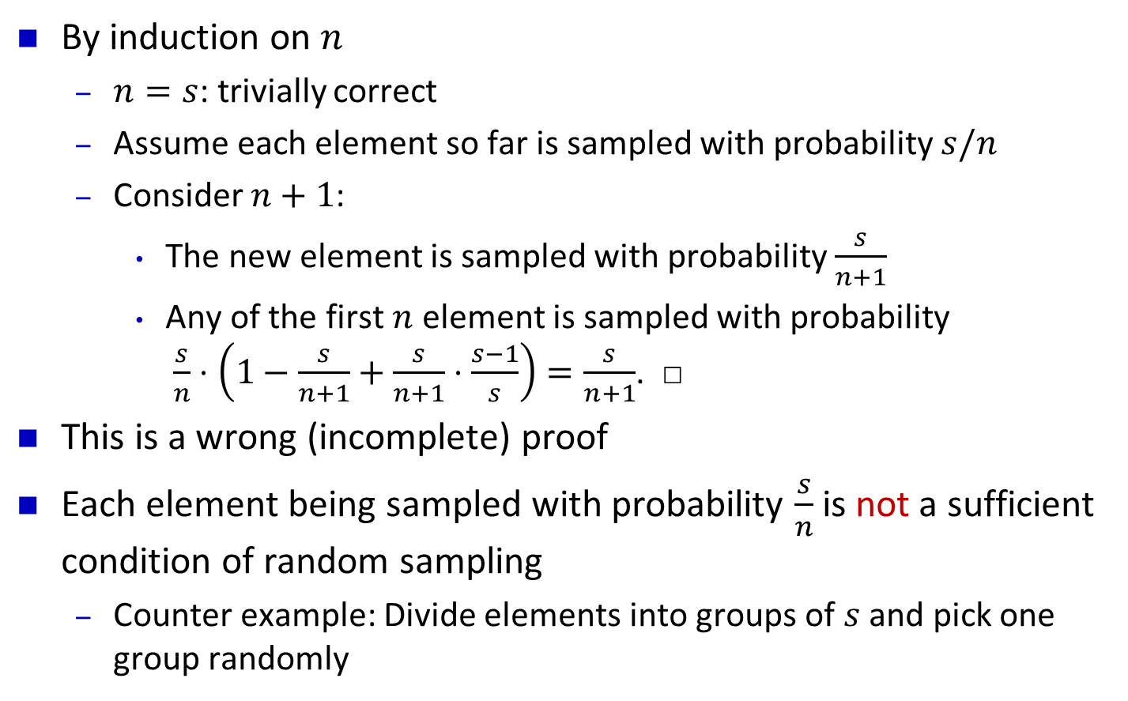
Correctness Proof
By induction on $n$
  $n=s$: trivially correct
  Assume each element so far is sampled with probability $s/n$
  Consider $n+1$:
    The new element is sampled with probability $\frac{s}{n+1}$
    Any of the first $n$ element is sampled with probability
    $\frac{s}{n}⋅\left(1−\frac{s}{n+1}+\frac{s}{n+1}⋅\frac{s−1}{s}\right)=\frac{s}{n+1}$. □
This is a wrong (incomplete) proof
Each element being sampled with probability $\frac{s}{n}$ is not a sufficient condition of random sampling
  Counter example: Divide elements into groups of $s$ and pick one group randomly

Slide 12
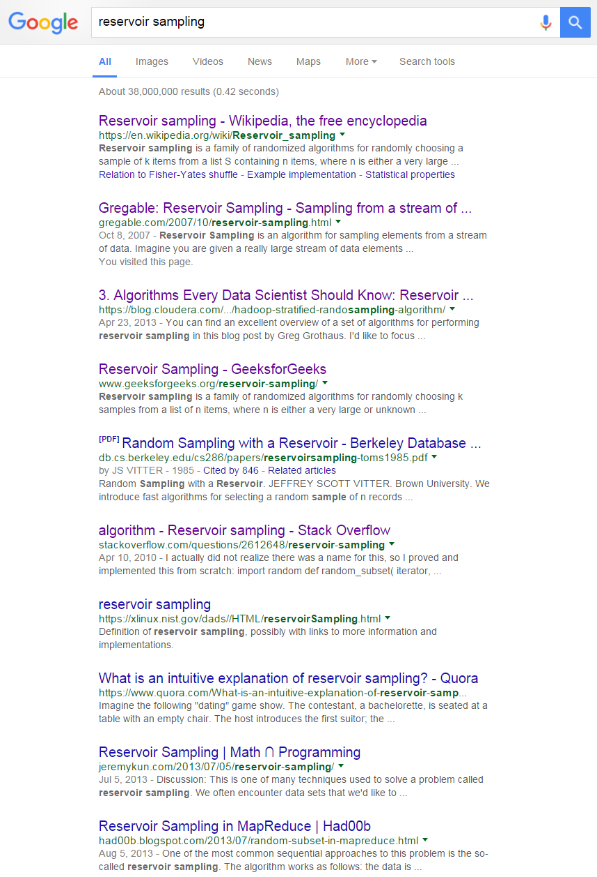


Slide 13
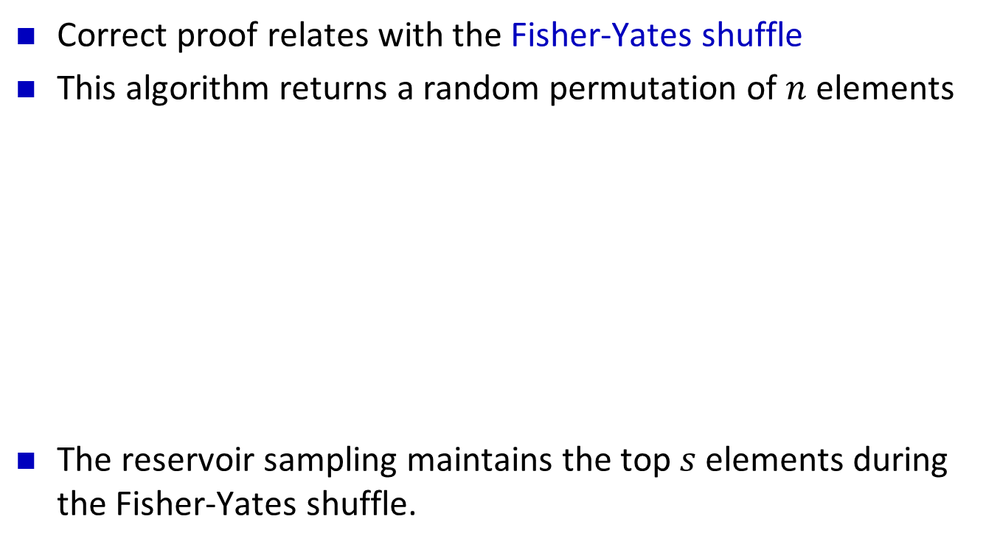
Reservoir Sampling Correctness Proof
Correct proof relates with the Fisher-Yates shuffle
This algorithm returns a random permutation of $n$ elements
The reservoir sampling maintains the top $s$ elements during the Fisher-Yates shuffle.
s = 2
a
a
b
b
b
b
b
a
c
d
c
c
c
a
a
d
d
d
d
c

Slide 14
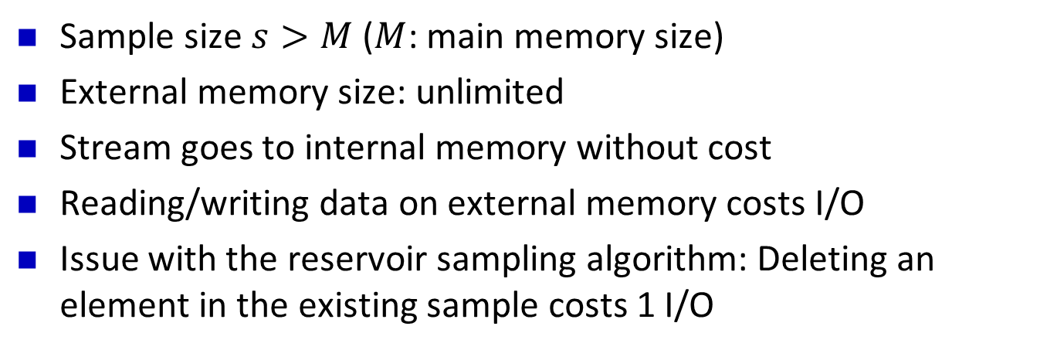

External Memory Stream Sampling
P
Internal Memory
Block size: $B$
External memory
Sample size $s>M$ ($M$: main memory size)
External memory size: unlimited
Stream goes to internal memory without cost
Reading/writing data on external memory costs I/O
Issue with the reservoir sampling algorithm: Deleting an element in the existing sample costs 1 I/O

Slide 15
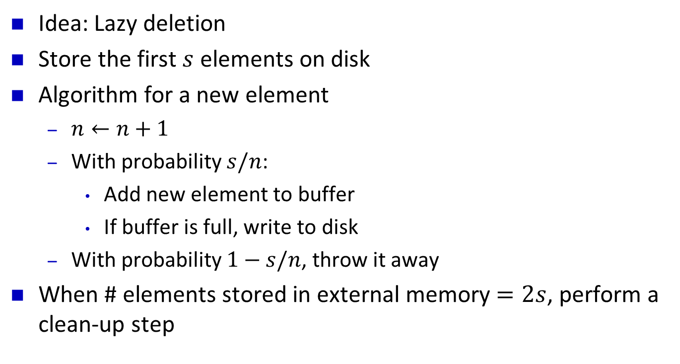
External Memory Stream Sampling
Idea: Lazy deletion
Store the first $s$ elements on disk
Algorithm for a new element
  $n←n+1$
  With probability $s/n$:
    Add new element to buffer
    If buffer is full, write to disk
  With probability $1−s/n$, throw it away
When # elements stored in external memory $=2s$, perform a clean-up step

Slide 16


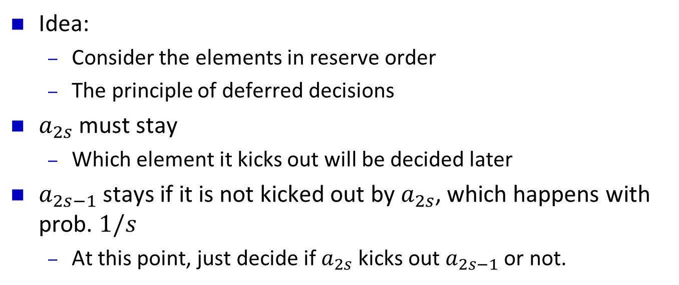
Clean-up Step
$$s$$
$$s$$
Idea:
  Consider the elements in reserve order
  The principle of deferred decisions
$a_{2s}$ must stay
  Which element it kicks out will be decided later
$a_{2s−1}$ stays if it is not kicked out by $a_{2s}$, which happens with prob. $1/s$
  At this point, just decide if $a_{2s}$ kicks out $a_{2s−1}$ or not.

Slide 17
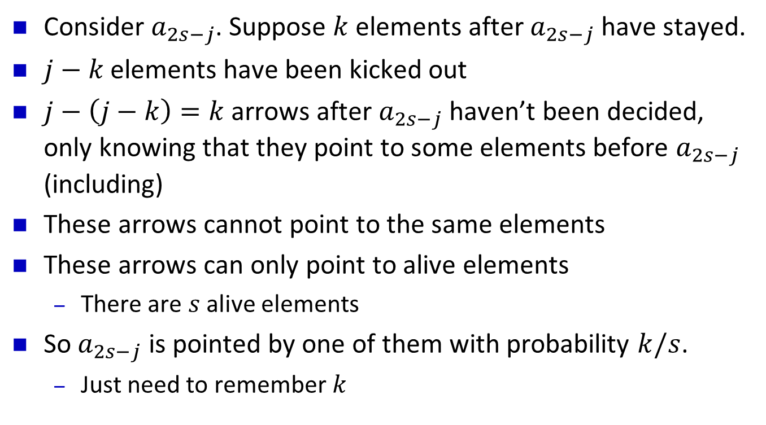
Clean-up Step
$$s$$
$$s$$
Consider $a_{2s−j}$. Suppose $k$ elements after $a_{2s−j}$ have stayed.
$j−k$ elements have been kicked out
$j−\left(j−k\right)=k$ arrows after $a_{2s−j}$ haven’t been decided, only knowing that they point to some elements before $a_{2s−j}$ (including)
These arrows cannot point to the same elements
These arrows can only point to alive elements
  There are $s$ alive elements
So $a_{2s−j}$ is pointed by one of them with probability $k/s$.
  Just need to remember $k$

Slide 18
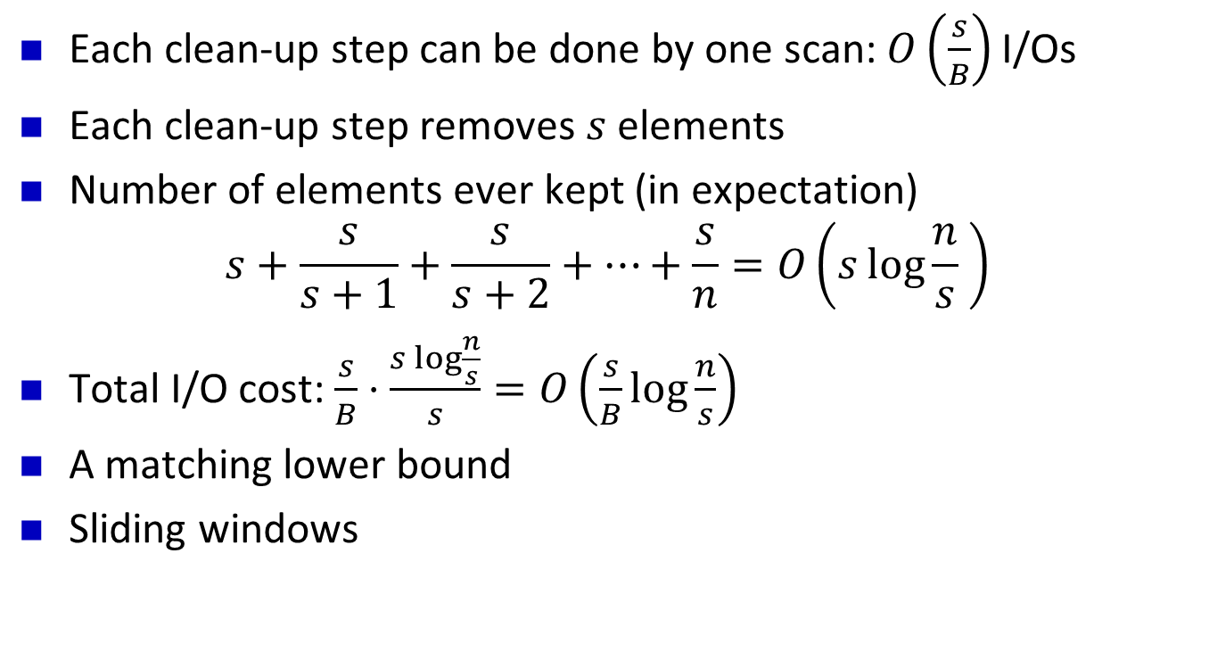
External Memory Stream Sampling
Each clean-up step can be done by one scan: $O\left(\frac{s}{B}\right)$ I/Os
Each clean-up step removes $s$ elements
Number of elements ever kept (in expectation)
$s+\frac{s}{s+1}+\frac{s}{s+2}+…+\frac{s}{n}=O\left(s\log{\frac{n}{s} }\right)$
Total I/O cost: $\frac{s}{B}⋅\frac{s\log{\frac{n}{s}}}{s}=O\left(\frac{s}{B}\log{\frac{n}{s}}\right)$
A matching lower bound
Sliding windows
[Gemulla and Lehner 06] [Hu, Qiao, Tao 15]

Slide 19
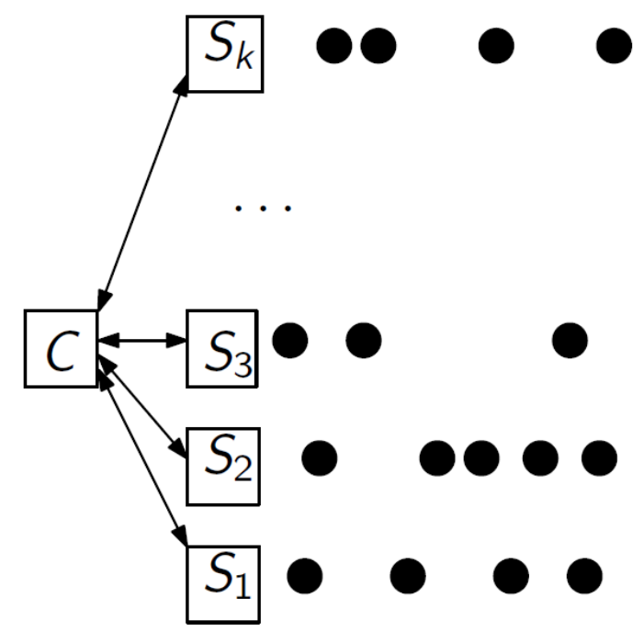
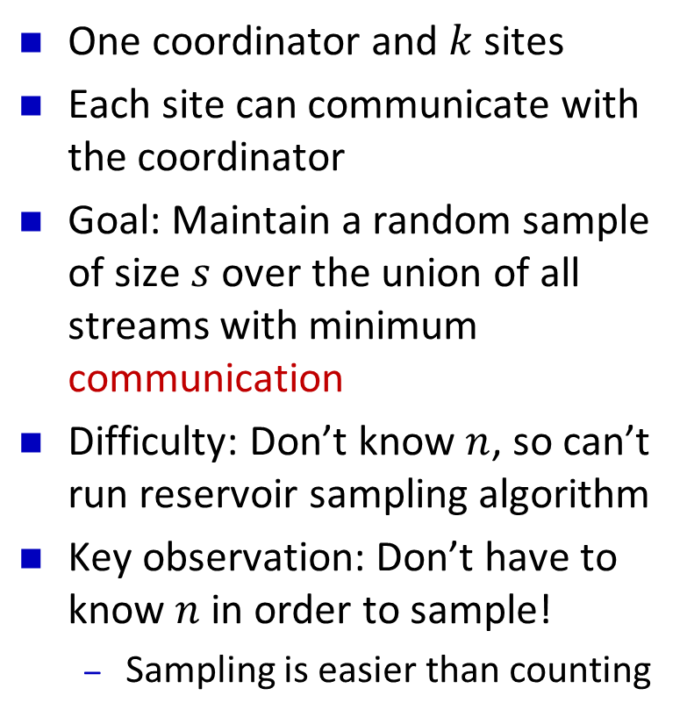
Sampling from Distributed Streams
One coordinator and $k$ sites
Each site can communicate with the coordinator
Goal: Maintain a random sample of size $s$ over the union of all streams with minimum communication
Difficulty: Don’t know $n$, so can’t run reservoir sampling algorithm
Key observation: Don’t have to know $n$ in order to sample!
  Sampling is easier than counting
[Cormode, Muthukrishnan, Yi, Zhang 09] [Woodruff, Tirthapura 11]

Slide 20
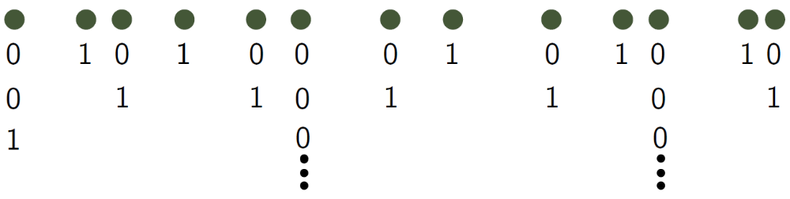
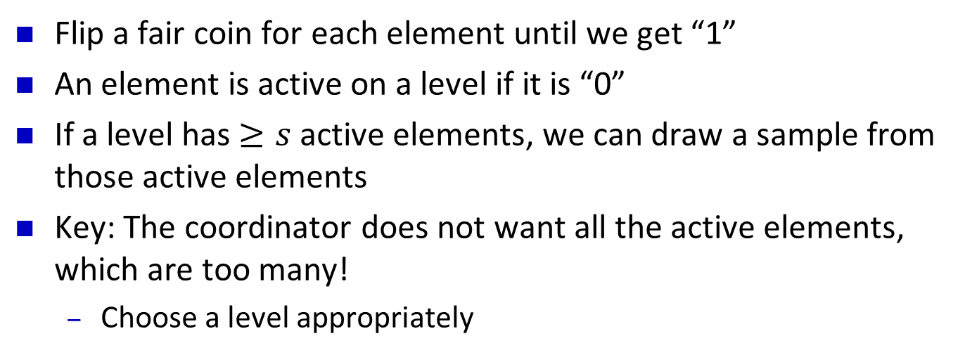
Reduction from Coin Flip Sampling
Flip a fair coin for each element until we get “1”
An element is active on a level if it is “0”
If a level has $≥s$ active elements, we can draw a sample from those active elements
Key: The coordinator does not want all the active elements, which are too many!
  Choose a level appropriately

Slide 21
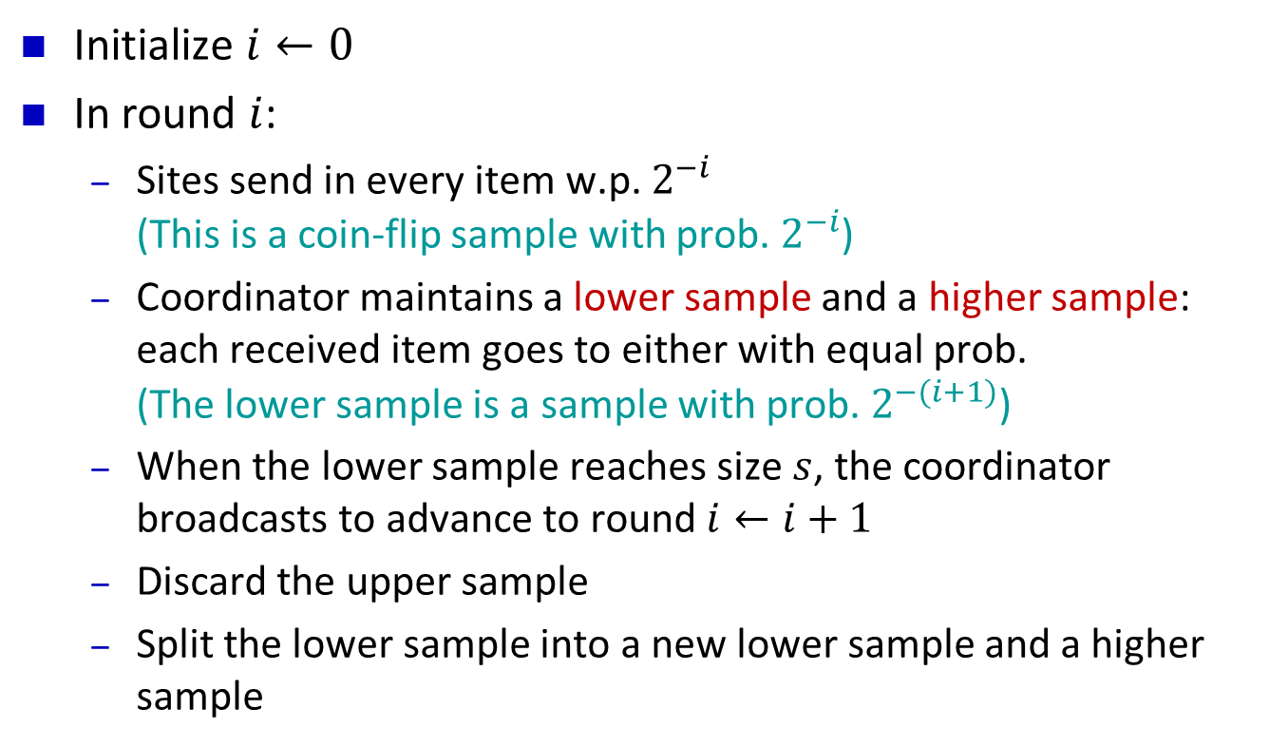
The Algorithm
Initialize $i←0$
In round $i$:
  Sites send in every item w.p. $2^{−i}$
  (This is a coin-flip sample with prob. $2^{−i}$)
  Coordinator maintains a lower sample and a higher sample: each received item goes to either with equal prob.
  (The lower sample is a sample with prob. $2^{−(i+1)}$)
  When the lower sample reaches size $s$, the coordinator broadcasts to advance to round $i←i+1$
  Discard the upper sample
  Split the lower sample into a new lower sample and a higher sample

Slide 22
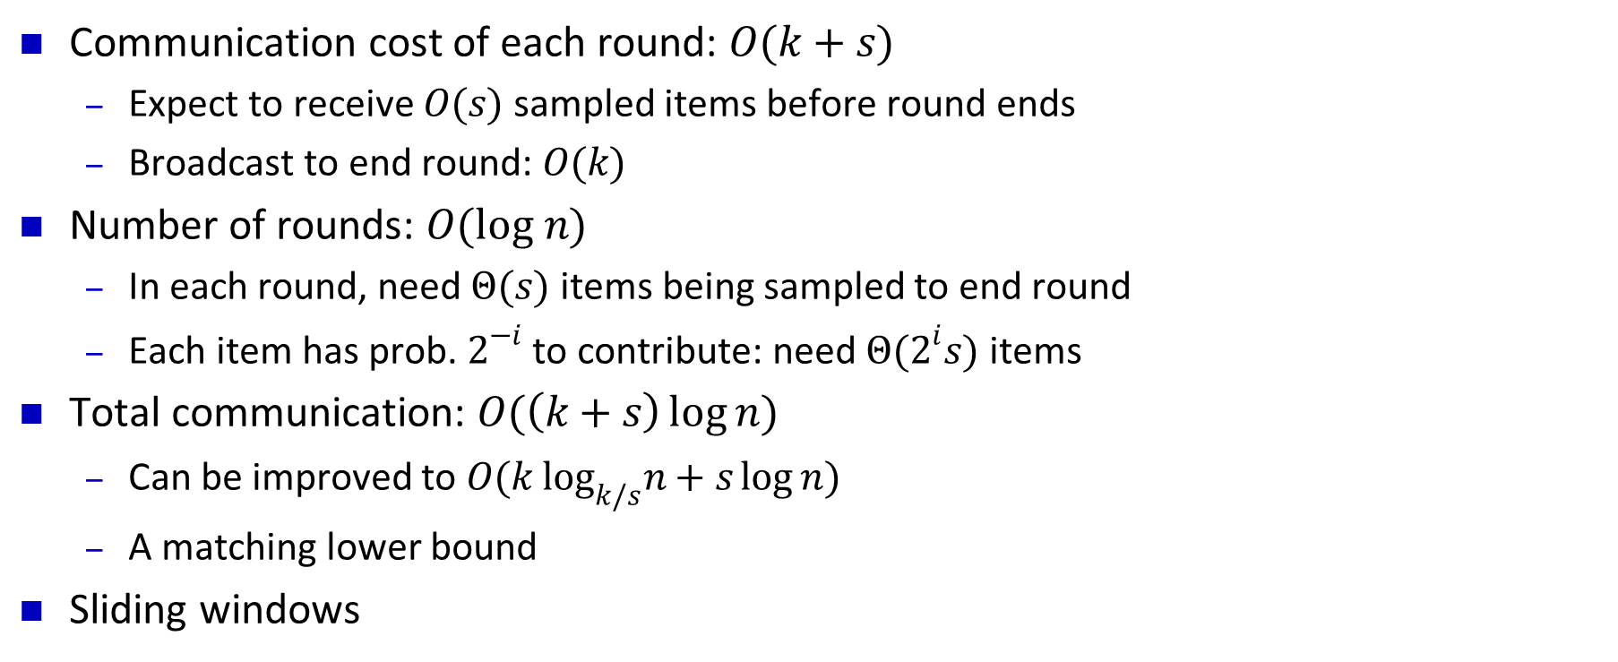
Communication Cost of Algorithm
Communication cost of each round: $O(k+s)$
  Expect to receive $O(s)$ sampled items before round ends
  Broadcast to end round: $O(k)$
Number of rounds: $O(log n)$
  In each round, need $Θ(s)$ items being sampled to end round
  Each item has prob. $2^{−i}$ to contribute: need $Θ(2^{i}s)$ items
Total communication: $O(\left(k+s\right)\log{n})$
  Can be improved to $O(k \log_{k/s}n+s\log{n})$
  A matching lower bound
Sliding windows

Slide 23
Importance Sampling
Sampling probability depends on how important data is

Slide 24
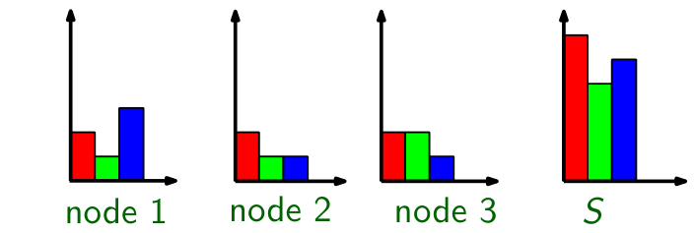
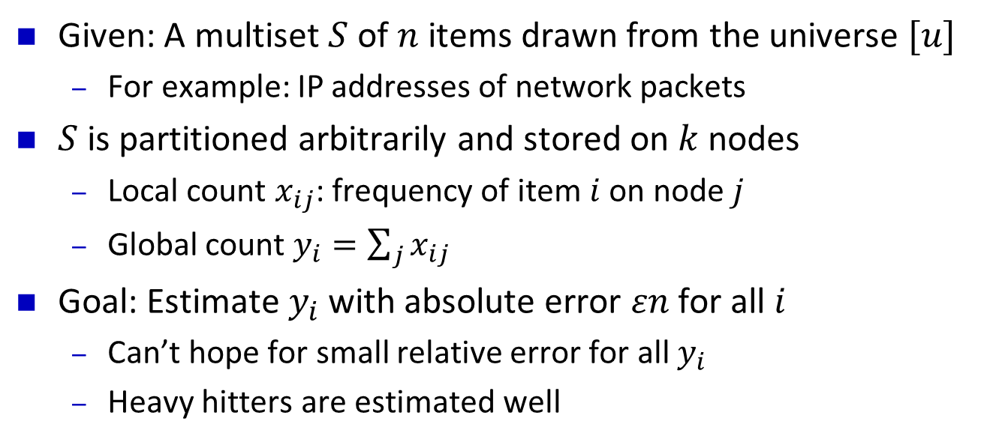
Frequency Estimation on Distributed Data
Given: A multiset $S$ of $n$ items drawn from the universe $[u]$
  For example: IP addresses of network packets
$S$ is partitioned arbitrarily and stored on $k$ nodes
  Local count $x_{ij}$: frequency of item $i$ on node $j$
  Global count $y_{i}=\sum_{j}{x_{ij}}$
Goal: Estimate $y_{i}$ with absolute error $εn$ for all $i$
  Can’t hope for small relative error for all $y_{i}$
  Heavy hitters are estimated well
[Zhao, Ogihara, Wang, Xu 06] [Huang, Yi, Liu, Chen 11]

Slide 25
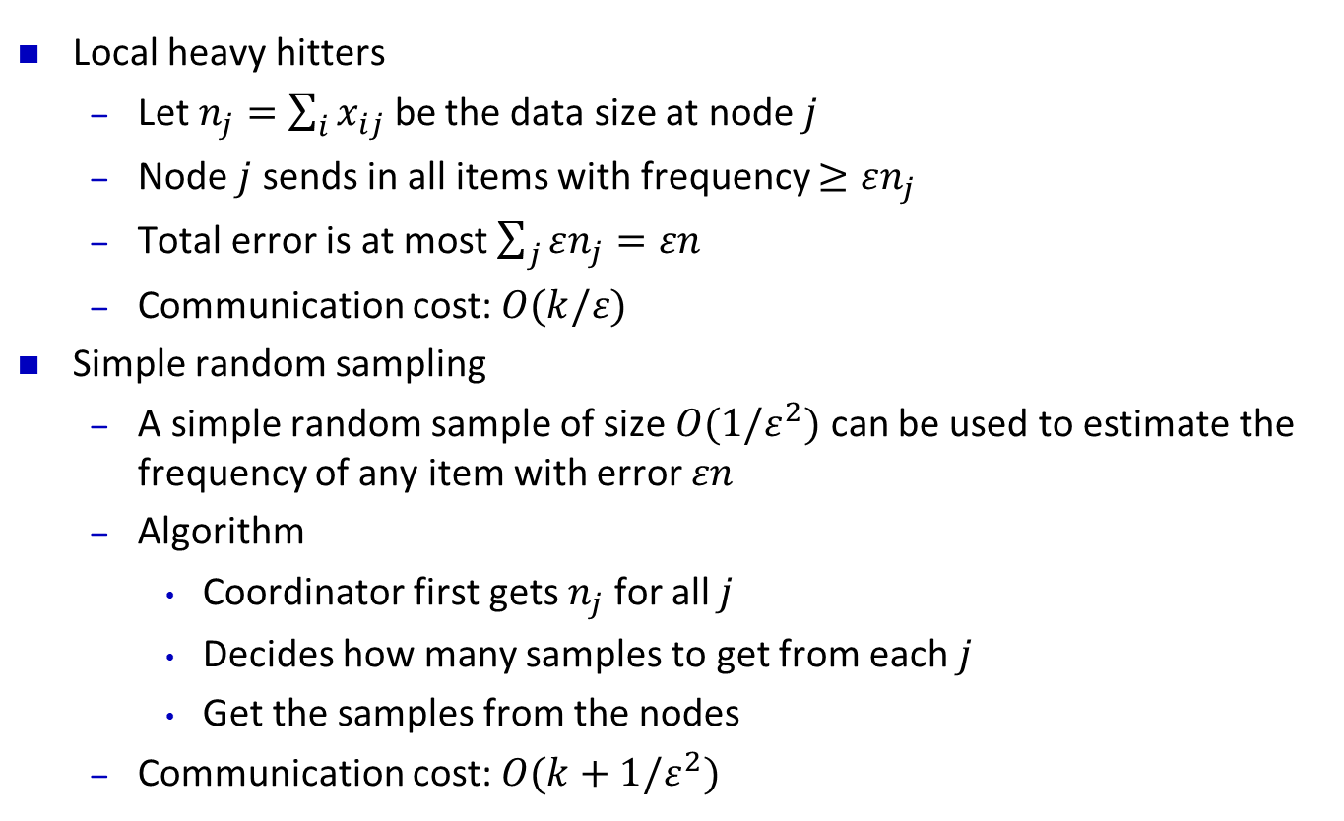
Frequency Estimation: Standard Solutions
Local heavy hitters
  Let $n_{j}=\sum_{i}{x_{ij}}$ be the data size at node $j$
  Node $j$ sends in all items with frequency $≥εn_{j}$
  Total error is at most $\sum_{j}{εn_{j}=εn}$
  Communication cost: $O(k/ε)$
Simple random sampling
  A simple random sample of size $O(1/ε^{2})$ can be used to estimate the frequency of any item with error $εn$
  Algorithm
    Coordinator first gets $n_{j}$ for all $j$
    Decides how many samples to get from each $j$
    Get the samples from the nodes
  Communication cost: $O(k+1/ε^{2})$

Slide 26
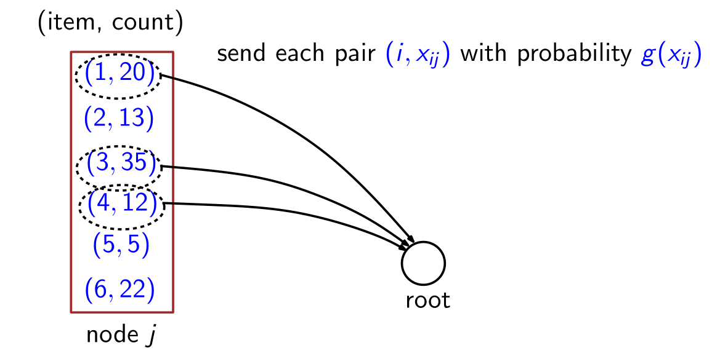
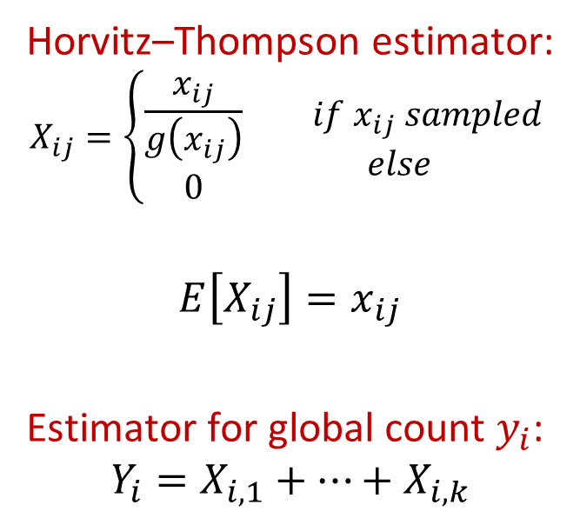
Importance Sampling
Horvitz–Thompson estimator:
$$X_{ij}=\left\{\begin{aligned}\frac{x_{ij}}{g\left(x_{ij}\right)} \\ 0\end{aligned}\right.\begin{matrix} if x_{ij} sampled \\ else\end{matrix}$$
$$E\left[X_{ij}\right]=x_{ij}$$
Estimator for global count $y_{i}$:
$$Y_{i}=X_{i,1}+…+X_{i,k}$$

Slide 27
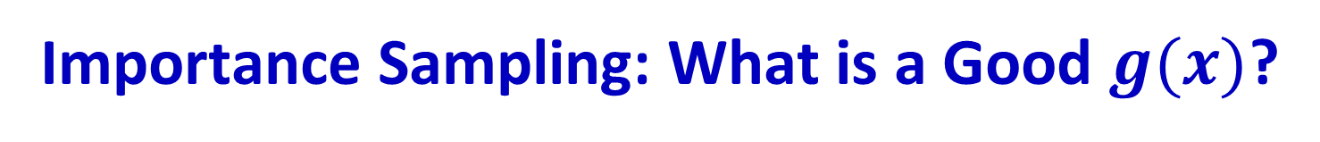
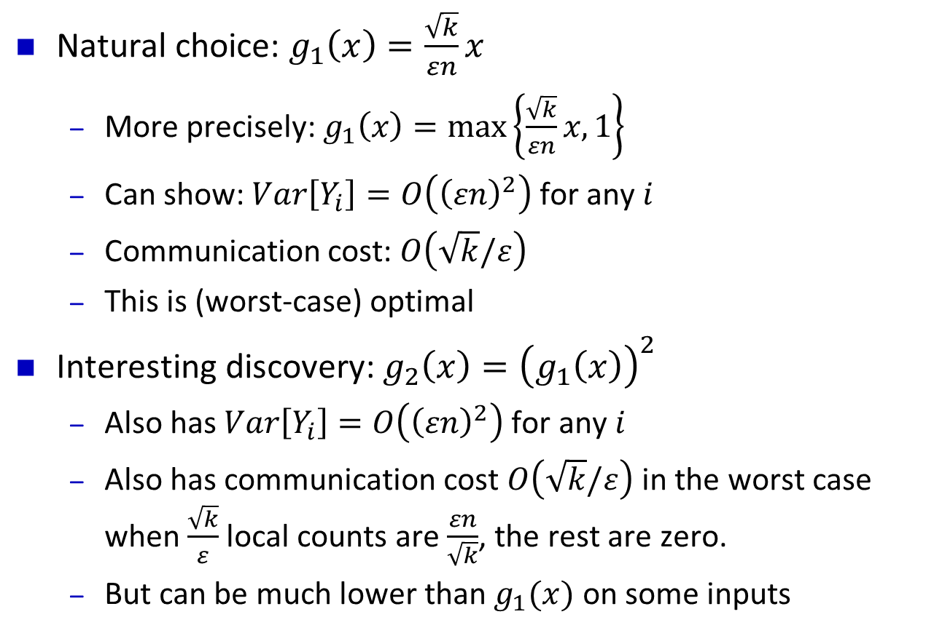
Importance Sampling: What is a Good $g(x)$?
Natural choice: $g_{1}\left(x\right)=\frac{\sqrt{k}}{εn}x$
  More precisely: $g_{1}\left(x\right)=\max\left\{\frac{\sqrt{k}}{εn}x,1\right\}$
  Can show: $Var\left[Y_{i}\right]=O\left({\left(εn\right)}^{2}\right)$ for any $i$
  Communication cost: $O\left(\sqrt{k}/ε\right)$
  This is (worst-case) optimal
Interesting discovery: $g_{2}\left(x\right)={\left(g_{1}\left(x\right)\right)}^{2}$
  Also has $Var\left[Y_{i}\right]=O\left({\left(εn\right)}^{2}\right)$ for any $i$
  Also has communication cost $O\left(\sqrt{k}/ε\right)$ in the worst case
  when $\frac{\sqrt{k}}{ε}$ local counts are $\frac{εn}{\sqrt{k}}$, the rest are zero.
  But can be much lower than $g_{1}(x)$ on some inputs

Slide 28


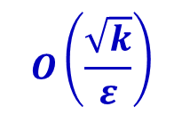
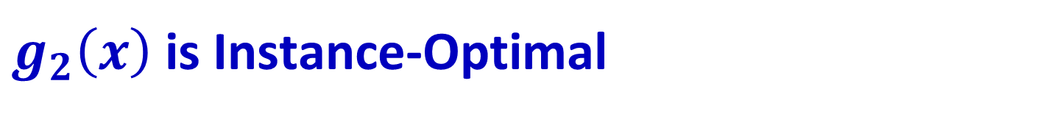
$g_{2}\left(x\right)$ is Instance-Optimal
Communication cost
$$O\left(\frac{\sqrt{k}}{ε}\right)$$
$$g_{1}$$
$$g_{2}$$
All possible inputs

Slide 29
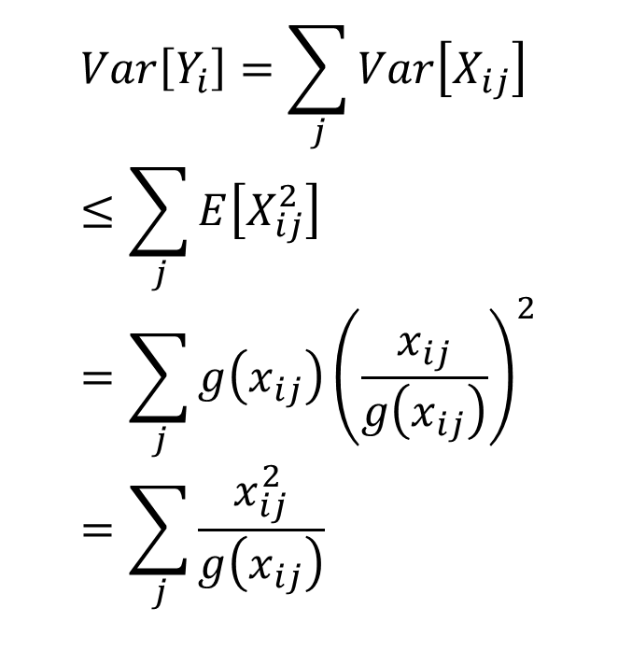
What Happened?
$$Var\left[Y_{i}\right]=\sum_{j}{Var\left[X_{ij}\right]} \\ ≤\sum_{j}{E\left[X_{ij}^{2}\right]} \\ =\sum_{j}{g\left(x_{ij}\right){\left(\frac{x_{ij}}{g\left(x_{ij}\right)}\right)}^{2}} \\ =\sum_{j}{\frac{x_{ij}^{2}}{g\left(x_{ij}\right)}}$$
Making $g\left(x_{ij}\right)∝x_{ij}^{2}$ removes all effects of the input

Slide 30



Variance-Communication Duality
Variance
$$O\left({\left(εn\right)}^{2}\right)$$
$$g_{2}$$
$$g_{1}$$
All possible inputs

Slide 31
Merge-Reduce Sampling
Better than simple random sampling

Slide 32
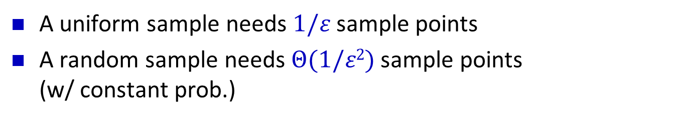
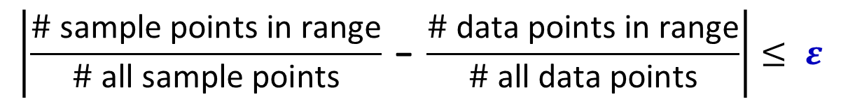
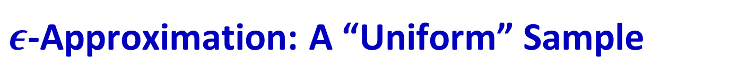
$ε$-Approximation: A “Uniform” Sample
Random sample:
$$\left|\frac{\# \text{sample} \text{points} \text{in} \text{range}}{\# \text{all} \text{sample} \text{points}} \text{−} \frac{\# \text{data} \text{points} \text{in} \text{range}}{\# \text{all} \text{data} \text{points}}\right|≤ ε$$
A uniform sample needs $1/ε$ sample points
A random sample needs $Θ(1/ε2)$ sample points
(w/ constant prob.)

Slide 33
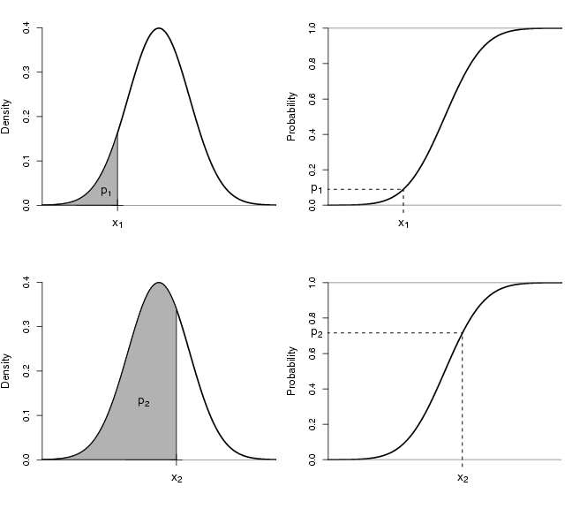
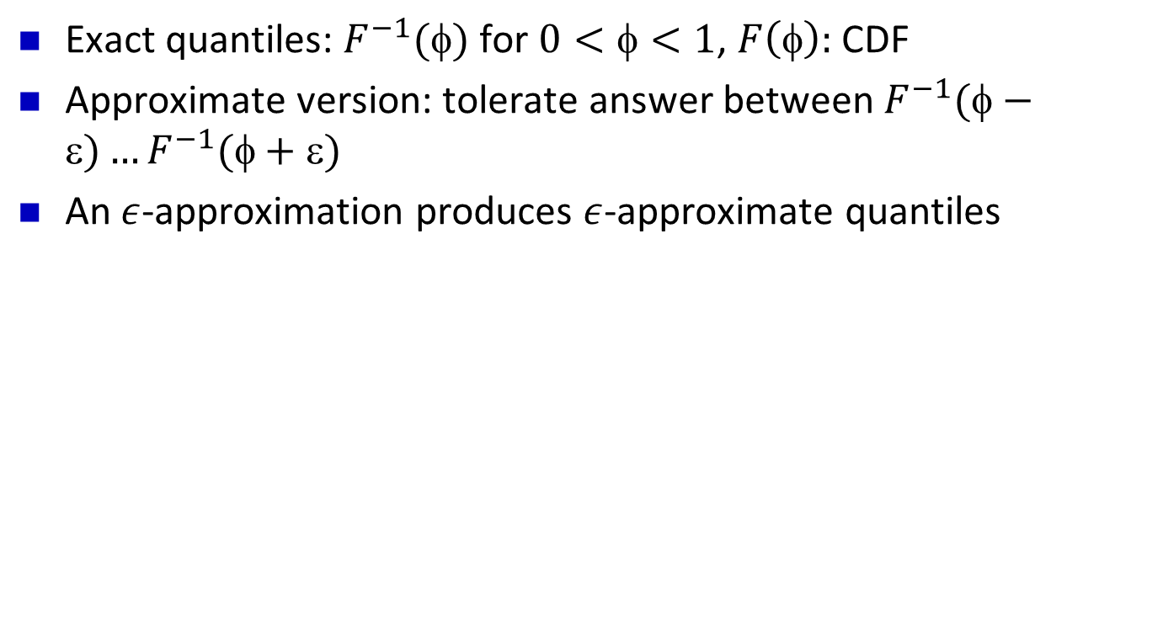
Median and Quantiles (order statistics)
Exact quantiles: $F^{−1}()$ for $0<<1$, $F\left(φ\right):$ CDF
Approximate version: tolerate answer between $F^{−1}(−)…F^{−1}(+)$
An $ε$-approximation produces $ε$-approximate quantiles

Slide 34
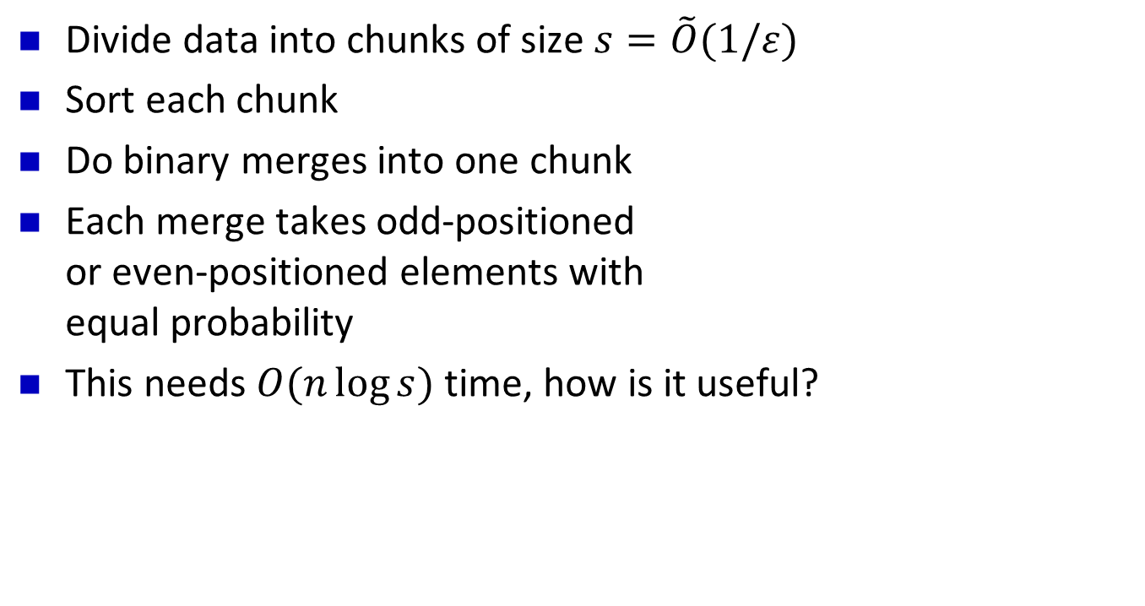
Merge-Reduce Sampling
Divide data into chunks of size $s=\tilde{O}(1/ε)$
Sort each chunk
Do binary merges into one chunk
Each merge takes odd-positioned
or even-positioned elements with
equal probability
This needs $O(n\log{s})$ time, how is it useful?
1 5 6 7 8
+
2 3 4 9 10
1 3 5 7 9

Slide 35
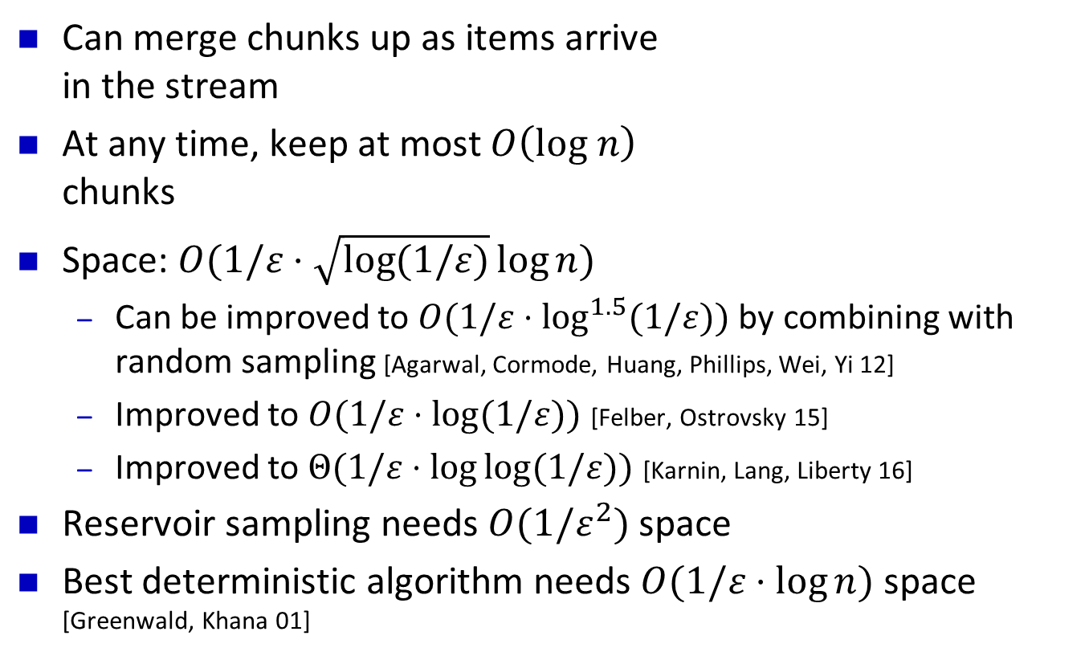
Application 1: Streaming Computation
Can merge chunks up as items arrive
in the stream
At any time, keep at most $O\left(log n\right)$
chunks
Space: $O(1/ε⋅\sqrt{\log{(1/ε)}}\log{n})$
  Can be improved to $O(1/ε⋅\log^{1.5}{(1/ε)})$ by combining with random sampling [Agarwal, Cormode, Huang, Phillips, Wei, Yi 12]
  Improved to $O(1/ε⋅\log{(1/ε)})$ [Felber, Ostrovsky 15]
  Improved to $Θ(1/ε⋅\log{\log{(1/ε)}})$ [Karnin, Lang, Liberty 16]
Reservoir sampling needs $O(1/ε^{2})$ space
Best deterministic algorithm needs $O(1/ε⋅\log{n})$ space [Greenwald, Khana 01]

Slide 36
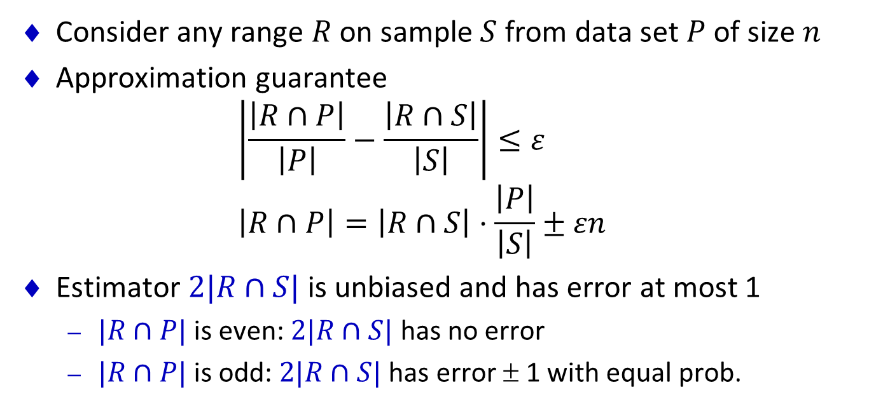
Error Analysis: Base case
Consider any range $R$ on sample $S$ from data set $P$ of size $n$
Approximation guarantee
$\left|\frac{\left|R∩P\right|}{\left|P\right|}−\frac{\left|R∩S\right|}{\left|S\right|}\right|≤ε$
$\left|R∩P\right|=\left|R∩S\right|⋅\frac{\left|P\right|}{\left|S\right|}±εn$
Estimator $2|R∩S|$ is unbiased and has error at most 1
  $|R∩P|$ is even: $2|R∩S|$ has no error
  $|R∩P|$ is odd: $2|R∩S|$ has error ± 1 with equal prob.

Slide 37
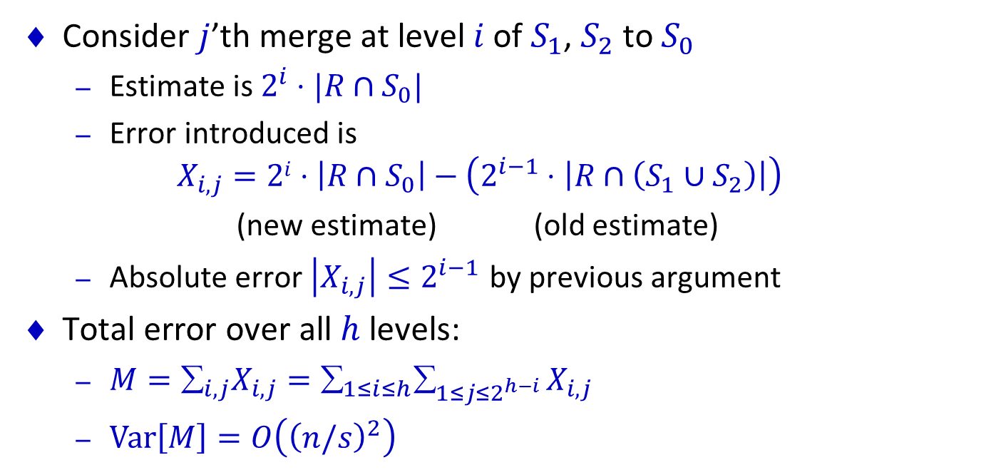
Error Analysis: General Case
Consider $j$’th merge at level $i$ of $S_{1}$, $S_{2}$ to $S_{0}$
  Estimate is $2^{i}⋅|R∩S_{0}|$
  Error introduced is
  $X_{i,j}=2i⋅\left|R∩S_{0}\right|−\left(2^{i−1}⋅\left|R∩\left(S_{1}∪S_{2}\right)\right|\right)$
  (new estimate) (old estimate)
  Absolute error $\left|X_{i,j}\right|≤2^{i−1}$ by previous argument
Total error over all $h$ levels:
  $M=_{i,j}X_{i,j}=_{1≤i≤h}_{1≤j≤2^{h−i }}X_{i,j}$
  $Var\left[M\right]=O\left({\left(n/s\right)}^{2}\right)$
Level 4
Level 3
Level 2
Level 1

Slide 38
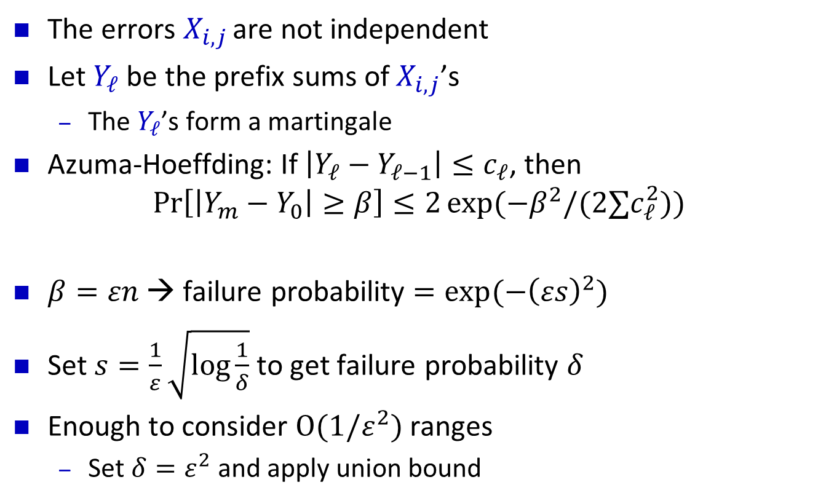
Error Analysis: Azuma-Hoeffding
The errors $X_{i,j}$ are not independent
Let $Y_{ℓ}$ be the prefix sums of $X_{i,j}$’s
  The $Y_{ℓ}$’s form a martingale
Azuma-Hoeffding: If $\left|Y_{ℓ}−Y_{ℓ−1}\right|≤c_{ℓ}$, then
$\operatorname{Pr}\left[\left|Y_{m}−Y_{0}\right|≥β\right]≤2\exp{(−β^{2}/(2∑c_{ℓ}^{2}))}$
$β=εn$ → failure probability $=\exp{(−{\left(εs\right)}^{2})}$
Set $s=\frac{1}{ε}\sqrt{\log{\frac{1}{δ}}}$ to get failure probability $δ$
Enough to consider $O(1/ε^{2})$ ranges
  Set $δ=ε^{2}$ and apply union bound

Slide 39
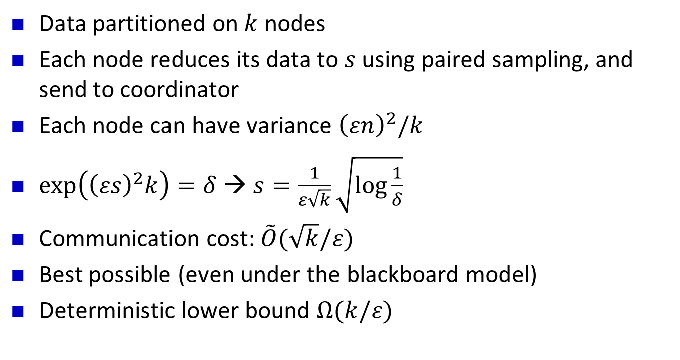
Application 2: Distributed Data
Data partitioned on $k$ nodes
Each node reduces its data to $s$ using paired sampling, and send to coordinator
Each node can have variance ${\left(εn\right)}^{2}/k$
$\exp\left({\left(εs\right)}^{2}k\right)=δ$ → $s=\frac{1}{ε\sqrt{k}}\sqrt{\log{\frac{1}{δ}}}$
Communication cost: $\tilde{O}(\sqrt{k}/ε)$
Best possible (even under the blackboard model)
Deterministic lower bound $Ω(k/ε)$
[Huang, Yi 14]

Slide 40
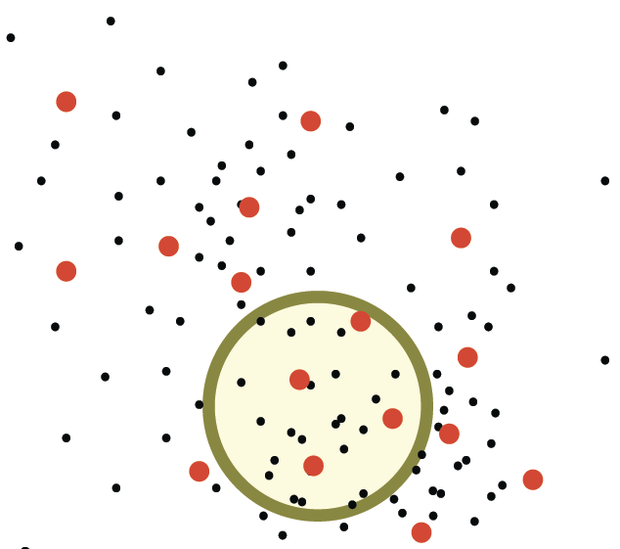
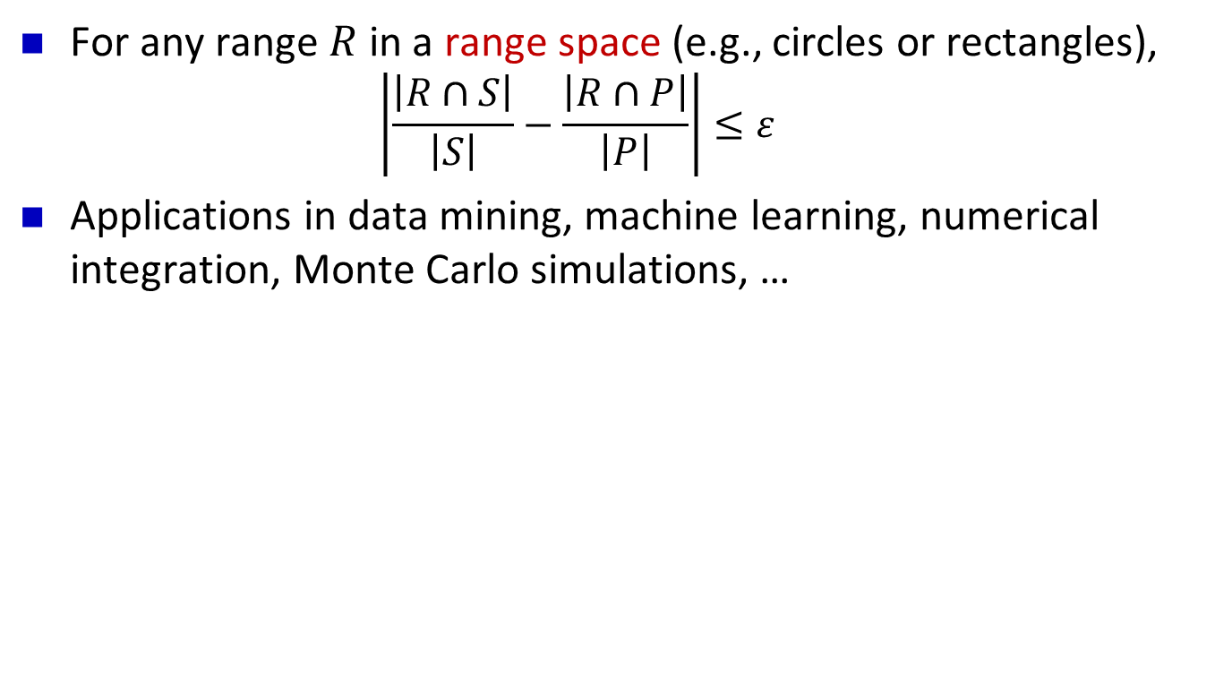
Generalization to Multi-dimensions
For any range $R$ in a range space (e.g., circles or rectangles),
  $$\left|\frac{\left|R∩S\right|}{\left|S\right|}−\frac{\left|R∩P\right|}{\left|P\right|}\right|≤ε$$
Applications in data mining, machine learning, numerical integration, Monte Carlo simulations, …

Slide 41
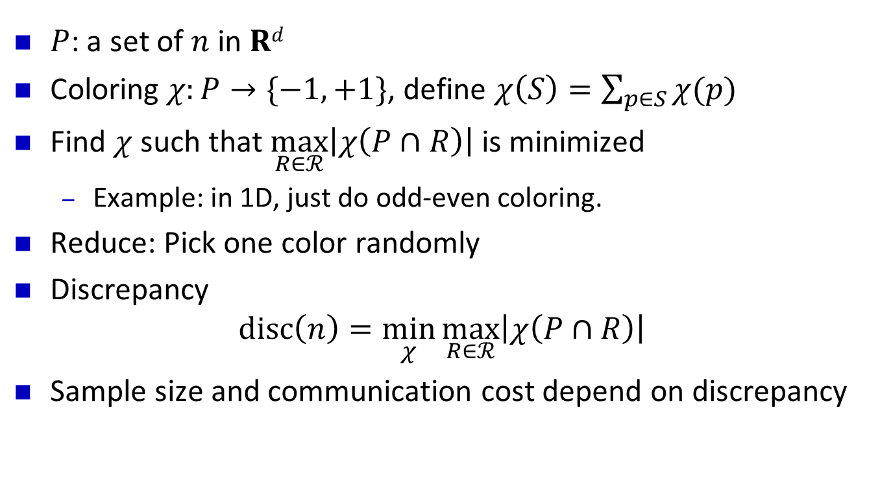
How to Reduce: Low-Discrepancy Coloring
$P$: a set of $n$ in $Rd$
Coloring $χ:P→\{−1,+1\}$, define $χ\left(S\right)=\sum_{p∈S}{χ(p)}$
Find $χ$ such that $\max_{R∈ℛ}\left|χ\left(P∩R\right)\right|$ is minimized
  Example: in 1D, just do odd-even coloring.
Reduce: Pick one color randomly
Discrepancy
$disc\left(n\right)=\min_{χ}{\max_{R∈ℛ}\left|χ\left(P∩R\right)\right|}$
Sample size and communication cost depend on discrepancy

Slide 42
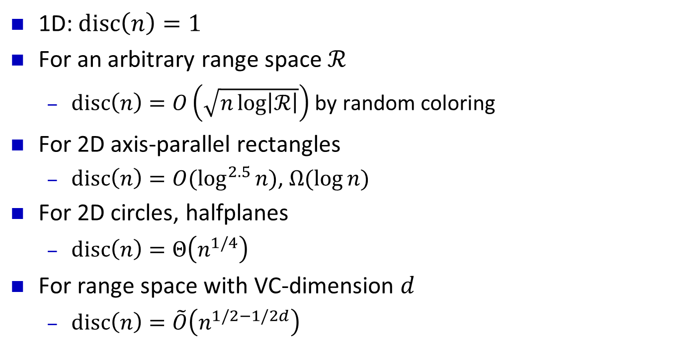
Known Discrepancy Results
1D: $disc\left(n\right)=1$
For an arbitrary range space $ℛ$
  $disc\left(n\right)=O\left(\sqrt{n\log\left|ℛ\right|}\right)$ by random coloring
For 2D axis-parallel rectangles
  $disc\left(n\right)=O(\log^{2.5}{n})$, $Ω(\log{n)}$
For 2D circles, halfplanes
  $disc\left(n\right)=Θ\left(n^{1/4}\right)$
For range space with VC-dimension $d$
  $disc\left(n\right)=\tilde{O}\left(n^{1/2−1/2d}\right)$

Slide 43
Sampling for
Approximate Query Processing

Slide 44
Complex Analytical Queries (TPC-H)
SELECT SUM(l_price)
FROM customer, lineitem, orders, nation, region
WHERE c_custkey = o_custkey
AND l_orderkey = o_orderkey
AND l_shipdate >= 2017-03-01
AND l_shipdate <= 2017-03-22
AND c_nationkey = n_nationkey
AND n_regionkey = r_regionkey
AND r_name = 'ASIA‘
Things to consider:
What to return?
  Simple aggregation (COUNT, SUM)
  A sample (UDFs)
Pre-computation allowed?
  Pre-computed samples, indexes

Slide 45
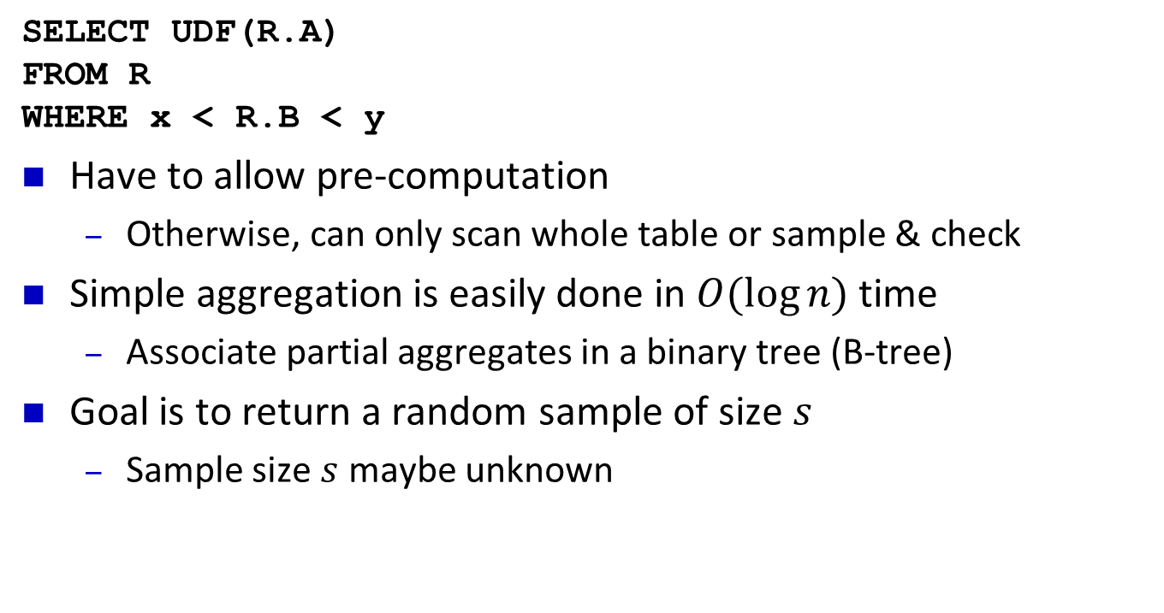
Sampling from One Table
SELECT UDF(R.A)
FROM R
WHERE x < R.B < y
Have to allow pre-computation
  Otherwise, can only scan whole table or sample & check
Simple aggregation is easily done in $O(\log{n)}$ time
  Associate partial aggregates in a binary tree (B-tree)
Goal is to return a random sample of size $s$
  Sample size $s$ maybe unknown

Slide 46
Binary Tree with Pre-computed Samples
Report:
5
Active nodes
5
7
14
3
8
12
14
1
4
5
7
9
12
14
16
1
2
3
4
5
6
7
8
9
10
11
12
13
14
15
16

Slide 47
Binary Tree with Pre-computed Samples
Report: 5
Active nodes
5
7
14
3
8
12
14
1
4
5
7
9
12
14
16
1
2
3
4
5
6
7
8
9
10
11
12
13
14
15
16

Slide 48
Binary Tree with Pre-computed Samples
Report: 5
7
Active nodes
5
Pick 7 or 14 with equal prob.
7
14
3
8
12
14
1
4
5
7
9
12
14
16
1
2
3
4
5
6
7
8
9
10
11
12
13
14
15
16

Slide 49
Binary Tree with Pre-computed Samples
Report: 5 7
Active nodes
5
Pick 3, 8, or 14
with prob. 1:1:2
7
14
3
8
12
14
1
4
5
7
9
12
14
16
1
2
3
4
5
6
7
8
9
10
11
12
13
14
15
16

Slide 50
Binary Tree with Pre-computed Samples
Report: 5 7
Active nodes
5
7
14
3
8
12
14
1
4
5
7
9
12
14
16
1
2
3
4
5
6
7
8
9
10
11
12
13
14
15
16

Slide 51
Binary Tree with Pre-computed Samples
Report: 5 7
12
Active nodes
5
Pick 3, 8, or 12
with equal prob
7
14
3
8
12
14
1
4
5
7
9
12
14
16
1
2
3
4
5
6
7
8
9
10
11
12
13
14
15
16
[Wang, Christensen, Li, Yi 16]

Slide 52
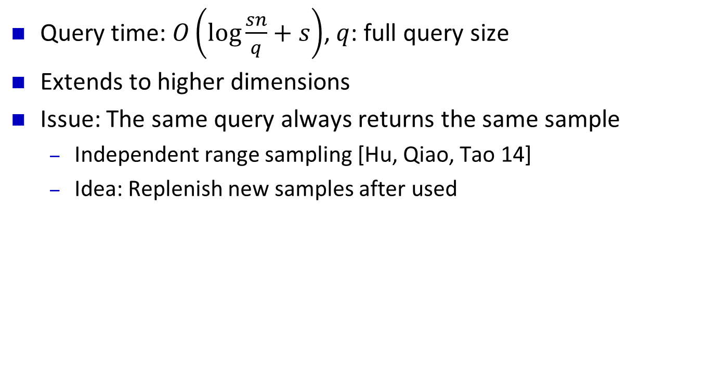
Binary Tree with Pre-computed Samples
Query time: $O\left(\log{\frac{sn}{q}+s}\right)$, $q$: full query size
Extends to higher dimensions
Issue: The same query always returns the same sample
  Independent range sampling [Hu, Qiao, Tao 14]
  Idea: Replenish new samples after used

Slide 53
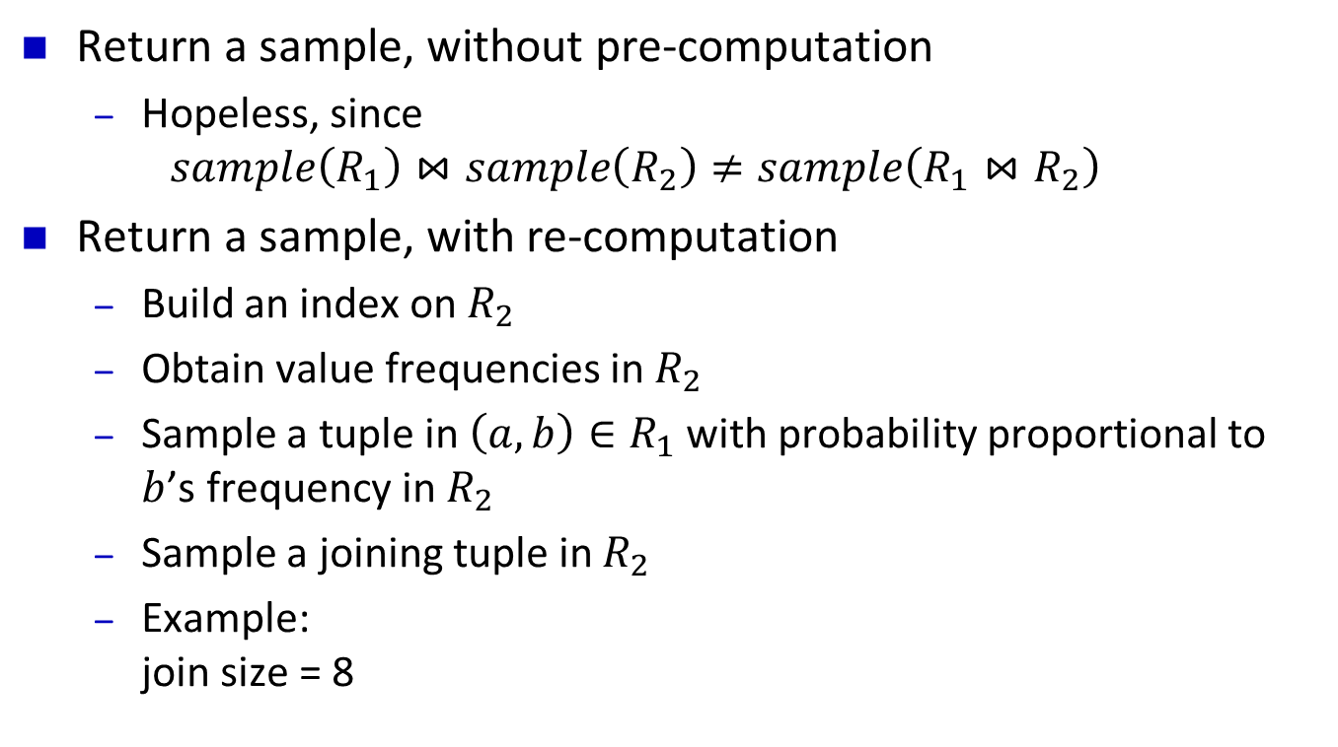
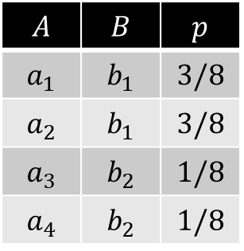
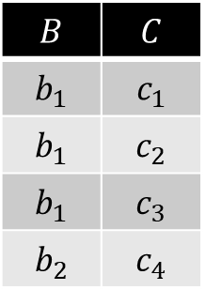
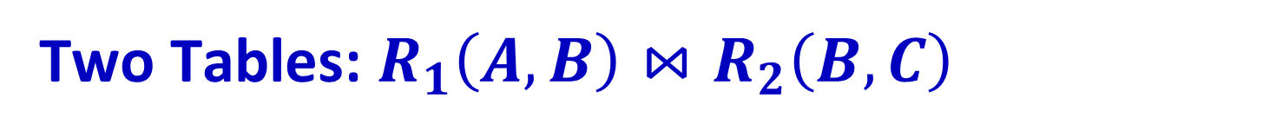
Two Tables: $R_{1}\left(A,B\right)⋈R_{2}\left(B,C\right)$
Return a sample, without pre-computation
  Hopeless, since
  $sample\left(R_{1}\right)⋈sample\left(R_{2}\right)≠sample\left(R_{1}⋈R_{2}\right)$
Return a sample, with re-computation
  Build an index on $R_{2}$
  Obtain value frequencies in $R_{2}$
  Sample a tuple in $\left(a,b\right)∈R_{1}$ with probability proportional to $b$’s frequency in $R_{2}$
  Sample a joining tuple in $R_{2}$
  Example:
  join size = 8
[Chaudhuri, Motwani, Narasayya 99]

Slide 54
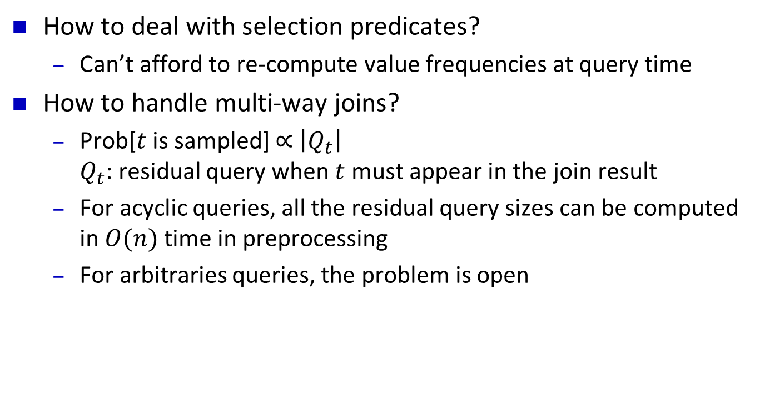
Sampling Joins: Open Problems
How to deal with selection predicates?
  Can’t afford to re-compute value frequencies at query time
How to handle multi-way joins?
  Prob[$t$ is sampled] $∝$ $\left|Q_{t}\right|$
  $Q_{t}$: residual query when $t$ must appear in the join result
  For acyclic queries, all the residual query sizes can be computed in $O(n)$ time in preprocessing
  For arbitraries queries, the problem is open

Slide 55
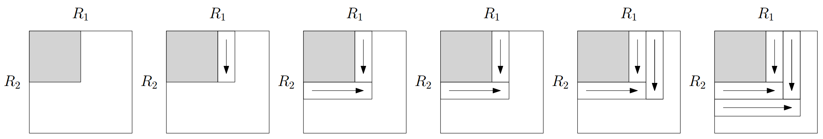
Two Tables: COUNT, No Pre-computation
Ripple join [Haas, Hellerstein 99]
  Sample a tuple from each table
  Join with previously sampled tuples from other tables
  The joined sampled tuples are not independent, but unbiased
Works well for full Cartesian product
  But most joins are sparse …
Can be extended to multiple tables but efficiency is even lower
What can be done with pre-computation (indexes)?

Slide 56
A Running Example
Nation | CID
US | 1
US | 2
China | 3
UK | 4
China | 5
US | 6
China | 7
UK | 8
Japan | 9
UK | 10
BuyerID | OrderID
4 | 1
3 | 2
1 | 3
5 | 4
5 | 5
5 | 6
3 | 7
5 | 8
3 | 9
7 | 10
OrderID | ItemID | Price
4 | 301 | $2100
2 | 304 | $100
3 | 201 | $300
4 | 306 | $500
3 | 401 | $230
1 | 101 | $800
2 | 201 | $300
5 | 101 | $200
4 | 301 | $100
2 | 201 | $600
What’s the total revenue of all orders from customers in China?

Slide 57
Join as a Graph
Nation | CID
US | 1
US | 2
China | 3
UK | 4
China | 5
US | 6
China | 7
UK | 8
Japan | 9
UK | 10
BuyerID | OrderID
4 | 1
3 | 2
1 | 3
5 | 4
5 | 5
5 | 6
3 | 7
5 | 8
3 | 9
7 | 10
OrderID | ItemID | Price
4 | 301 | $2100
2 | 304 | $100
3 | 201 | $300
4 | 306 | $500
3 | 401 | $230
1 | 101 | $800
2 | 201 | $300
5 | 101 | $200
4 | 301 | $100
2 | 201 | $600

Slide 58
Sampling by Random Walks
Nation | CID
US | 1
US | 2
China | 3
UK | 4
China | 5
US | 6
China | 7
UK | 8
Japan | 9
UK | 10
BuyerID | OrderID
4 | 1
3 | 2
1 | 3
5 | 4
5 | 5
5 | 6
3 | 7
5 | 8
3 | 9
7 | 10
OrderID | ItemID | Price
4 | 301 | $2100
2 | 304 | $100
3 | 201 | $300
4 | 306 | $500
3 | 401 | $230
1 | 101 | $800
2 | 201 | $300
5 | 101 | $200
4 | 301 | $100
2 | 201 | $600

Slide 59
Sampling by Random Walks
Nation | CID
US | 1
US | 2
China | 3
UK | 4
China | 5
US | 6
China | 7
UK | 8
Japan | 9
UK | 10
BuyerID | OrderID
4 | 1
3 | 2
1 | 3
5 | 4
5 | 5
5 | 6
3 | 7
5 | 8
3 | 9
7 | 10
OrderID | ItemID | Price
4 | 301 | $2100
2 | 304 | $100
3 | 201 | $300
4 | 306 | $500
3 | 401 | $230
1 | 101 | $800
2 | 201 | $300
5 | 101 | $200
4 | 301 | $100
2 | 201 | $600

Slide 60
Sampling by Random Walks
Nation | CID
US | 1
US | 2
China | 3
UK | 4
China | 5
US | 6
China | 7
UK | 8
Japan | 9
UK | 10
BuyerID | OrderID
4 | 1
3 | 2
1 | 3
5 | 4
5 | 5
5 | 6
3 | 7
5 | 8
3 | 9
7 | 10
OrderID | ItemID | Price
4 | 301 | $2100
2 | 304 | $100
3 | 201 | $300
4 | 306 | $500
3 | 401 | $230
1 | 101 | $800
2 | 201 | $300
5 | 101 | $200
4 | 301 | $100
2 | 201 | $600

Slide 61

Sampling by Random Walks
Nation | CID
US | 1
US | 2
China | 3
UK | 4
China | 5
US | 6
China | 7
UK | 8
Japan | 9
UK | 10
BuyerID | OrderID
4 | 1
3 | 2
1 | 3
5 | 4
5 | 5
5 | 6
3 | 7
5 | 8
3 | 9
7 | 10
OrderID | ItemID | Price
4 | 301 | $2100
2 | 304 | $100
3 | 201 | $300
4 | 306 | $500
3 | 401 | $230
1 | 101 | $800
2 | 201 | $300
5 | 101 | $200
4 | 301 | $100
2 | 201 | $600
Unbiased estimator: $\frac{\$500}{sampling prob.}=\frac{\$500}{1/3⋅1/4⋅1/3}$
Can also deal with selection predicates
[Li, Wu, Yi, Zhao 16]

Slide 62

Open Problem
Theoretical analysis of this random walk algorithm?
  Focus on COUNT
Connection to approximate triangle counting
  An $O\left(\frac{N^{1.5}}{T}\right)$-time algorithm for obtaining an constant-factor approximation of the number of triangles ($T$)
  [Eden, Levi, Ron, Seshadhri 15]
  The algorithm is essentially the same as the random walk algorithm (with the right parameters) applied to the triangle join
  $R_{1}\left(A,B\right)⋈R_{2}\left(B,C\right)⋈R_{3}(A,C)$
Conjecture: $O\left(\frac{AGM}{J}\right)$ time to estimate join size ($J$)
  Currently, computing COUNT is no easier than full join

Slide 63
Thank you!

