Slide 1
Graph Exploration:
From the User to Large Graphs
Davide Mottin, Emmanuel Müller
Hasso Plattner Institute, Potsdam, Germany
May 14, 2017
SIGMOD 2017, Chicago, US

Slide 2


Who we are
Davide Mottin
graph mining, novel query paradigms, interactive methods
https://hpi.de/en/mueller/team/davide-mottin.html
Emmanuel Müller
graph mining, stream mining, clustering and outlier mining on graphs, streams, and traditional databases
http://hpi.de/en/mueller/prof-dr-emmanuel-mueller.html
Slides: https://hpi.de//mueller/tutorials/graph-exploration-sigmod.html

Slide 3
Big data and novice users

Slide 4
Data exploration
Efficiently extracting knowledge from data
even if we do not know exactly what we are looking for
Idreos et al., Overview of Data Exploration Methods, SIGMOD 2015

Slide 5
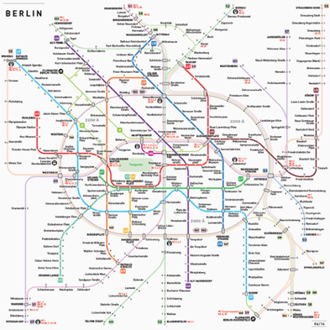

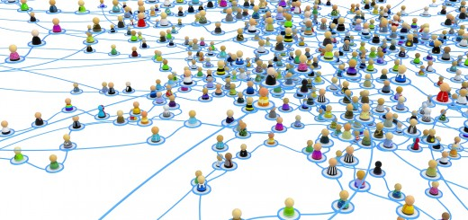




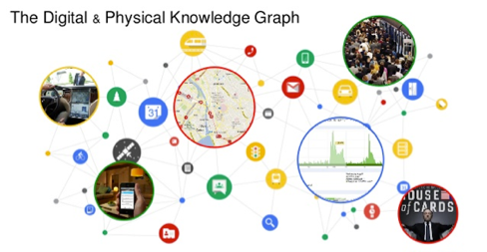





The importance of graphs
Complex
Ubiquitous
Large
Valuable
Social Networks
Road Networks
Recommendation Graphs
Knowledge Graphs
Notes:
Add a logo on top of the pictures (e.g. Facebook, Amazon … )

Slide 6
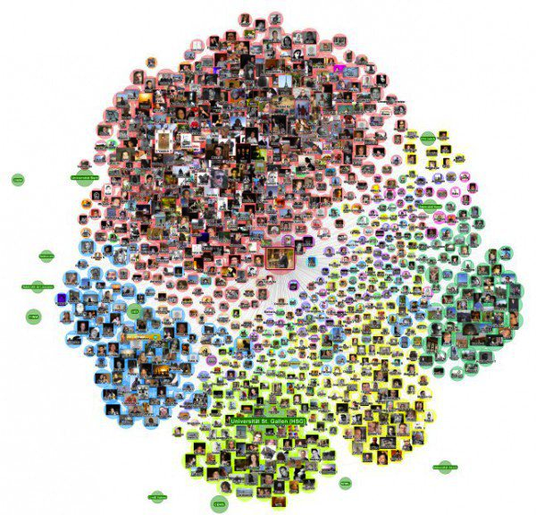
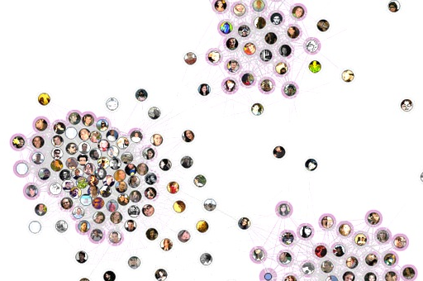
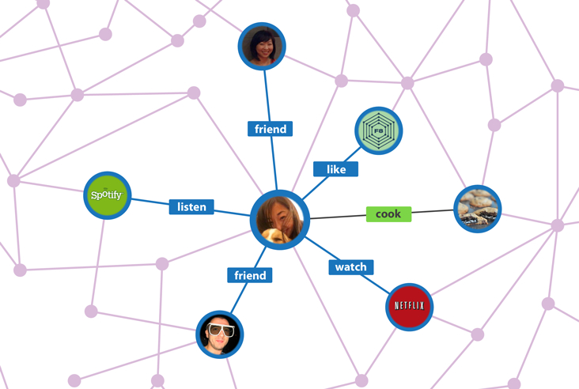
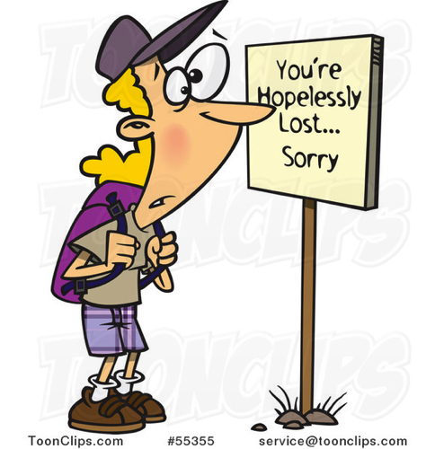
Lost in the graph?

Slide 7
Current: Visualization tools
Several visualization tools:
General: Gephi, GraphViz, …
Biological: Cytoscape, Network Workbench
Social: EgoNet, NodeXL, ...
Relational: Tulip
but
No Scalability to large networks!
No for novice users
Limited expressivity

Slide 8
Current: Query languages
SELECT ?name ?email
WHERE
{
?person a foaf:Person .
?person foaf:name ?name .
?person foaf:mbox ?email .
}
Query languages ARE:
Expressive
Powerful
Scalable
Compact
SPARQL
g.V().hasLabel('movie').as('a','b').
where(inE('rated').count().is(gt(10))).
select('a','b').
by('name').
by(inE('rated').values('stars').mean()).
order().
by(select('b'),decr). limit(10
but
Not user friendly
No guided search
Not interactive
Not scalable
GREMLIN
MATCH (node1:Label1)-->(node2:Label2)
WHERE node1.propertyA = {value}
RETURN node2.propertyA, node2.propertyB
CYPHER

Slide 9
This tutorial is about …
Algorithms for helping the user finding the wanted information
Approximate search on graphs to assist the user in finding the information
Interactive methods on graphs based on user feedback
Automatically discovery of portions of graphs using examples
NOT about
Visualization methods for graphs
Query languages and semantics
Efficient indexing methods
Pure machine learning on graphs

Slide 10
Our graph exploration taxonomy
Exploratory Graph Analysis
Focused Graph Mining
Refinement of Query Results
Notes:
Might be the section of the related work.
Doing research in one part

Slide 11
Graph exploration taxonomy
Exploratory Graph Analysis
Other politicians like Angela Merkel?
Schröder
Schröder
chancellor
chancellor
Merkel
chancellor
Germany
Imprecise match
Query is an example
Two exploratory options:
An imprecise query
A by-example query
President of
Gauch
Merkel
President of
?
Merkel
Chancellor
Germany

Slide 12
Graph exploration taxonomy
Focused Graph Mining
How can I see only the part of the graph I’m interested in?
They all like the Chicago Bulls
Ego-net analysis
Targeted analysis on large graphs
Focused graph clustering
Space restriction methods
Graph Reweighting

Slide 13
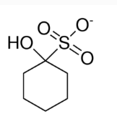
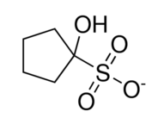
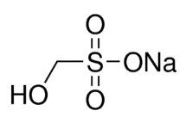
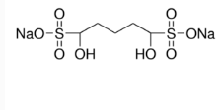
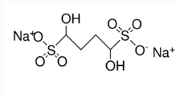
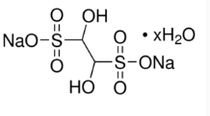
Graph exploration taxonomy
Refinement of Query Results
Where is this molecule contained?
1
2
4
6
Too many results!
O
5
3
7
OH
S
O
… + 500 results
Query reformulations
Dominance relation
Dealing with generic queries:
Reformulation and refinement
Top-k results
Skyline queries
O
O
OH
S
O
OH
S
O
H
CH₃
SH
270 results
220 results

Slide 14
The graph exploration … graph
Exploratory graph analytics
[Mottin14]
[Jayaram15]
[Tong06]
[Epasto15]
[Fan10]
[Staudt14]
[Khan13]
[Perozzi14]
[Ma14]
[Iglesias14]
[Yang14]
[Iglesias13]
Focused graph mining
[Wu13]
[Fan13]
[Ranu14]
[Vasilyeva16]
[Gupta14]
[Mottin15]
[Zou10]
Refinement of query results

Slide 15
Tutorial outline
Background (5 min)
Graph models, subgraph isomorphism, subgraph mining, graph clustering
Exploratory Graph Analysis (20 min)
Focused Graph Mining (20 min)
Refinement of Query Results (20 min)
Challenges and discussion

Slide 16
We are here
Background (5 min)
Graph models, subgraph isomorphism, subgraph mining, graph clustering
Exploratory Graph Analysis (20 min)
Focused Graph Mining (20 min)
Refinement of Query Results (20 min)
Challenges and discussion

Slide 17

Graphs
G = (V, E)
G = (V, E,p)
G = (V, E, l)
0.1
a
Vertices
Edges
Labeling function
Probability function
0.9
0.2
a
c
0.2
b
$$l:V∪E→Σ$$
0.5
a
0.3
b
0.6
c
Undirected Graphs
  Co-authorship, Roads, Biological
Directed graphs
  Follows, …
Labeled Graphs
  Knowledge graphs, …
Probabilistic graphs
  Causal graphs
0.8
b

Slide 18
Graph databases (set of graphs)
a
a
c
a
a
b
d
a
c
b
a
…
c
a
b
b
b
G₁
G₂
G₃
$$D=\left\{G_{1},G_{2}, …, G_{n}\right\}, G_{i}=〈V_{i},E_{i},l_{i}〉, l_{i}:E_{i}∪V_{i}→Σ$$
Set of small labeled graphs
Chemical compounds, Business models, 3D objects

Slide 19
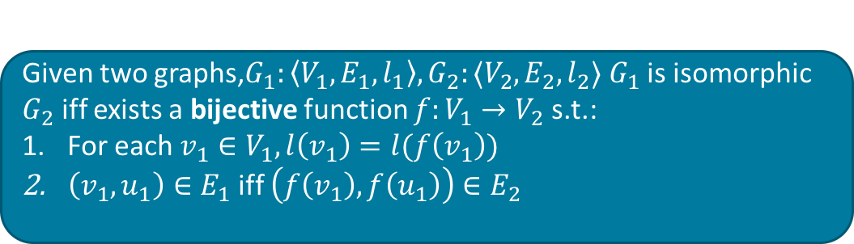
Graph Isomorphism
G₁
G₂
f
Given two graphs,$G_{1}:〈V_{1},E_{1},l_{1}〉, G_{2}:〈V_{2},E_{2},l_{2}〉 G_{1}$ is isomorphic $G_{2}$ iff exists a bijective function $f:V_{1}→V_{2}$ s.t.:
For each $v_{1}∈V_{1}, l\left(v_{1}\right)=l(f\left(v_{1}\right))$
$\left(v_{1},u_{1}\right)∈E_{1}$ iff $\left(f\left(v_{1}\right),f\left(u_{1}\right)\right)∈E_{2}$

Slide 20
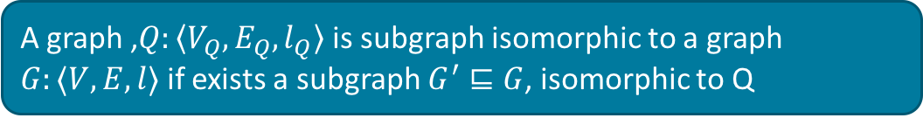
Subgraph Isomorphism
Q
G’
G
A graph ,$Q:〈V_{Q},E_{Q},l_{Q}〉$ is subgraph isomorphic to a graph $G:〈V,E,l〉$ if exists a subgraph $G^{′}⊑G$, isomorphic to Q

Slide 21
Graph Clustering and Community Detection
Given: graph with nodes, edges, labels
Discover: a partitioning of communities
C = {C₁, C₂, C₃, …, C_{k}}
Optimize a given quality criterion Q(C),
e.g. Modularity or other measures
Is an NP-hard problem to find the optimal partitioning
G = (V, E, l)
a
Vertices
Edges
Labeling function
a
c
$$l:V∪E→Σ$$
a
b
c
b

Slide 22
We are here
Background (5 min)
Graph models, subgraph isomorphism, subgraph mining, graph clustering
Exploratory Graph Analysis (20 min)
Focused Graph Mining (20 min)
Refinement of Query Results (20 min)
Challenges and discussion

Slide 23
Exploratory Search
Approximate Graph Search
Given an imprecise query find the closest answers to that query
User perspective: no need to know about the entire details of the data
Searching by Example
Given an example from the results, find the other results of an unspecified query
User perspective: it is not necessary to know how to describe the results

Slide 24
Approximate Graph Search
?
The user might be imprecise in the search terms
Solution
Query (a graph)
Find (partial) correspondence from the query to the graph
Graph
Structural mapping: Strong-simulation (Ma et al.)
Node similarity approaches: P-homomorphism (Fan et al.), Nema (Khan et al.)
Probabilistic approaches: SLQ (Yang et al.)

Slide 25
Subgraph isomorphism issues
(Sub)Graph Isomorphism might be too restrictive
X
No MATCH
(different label)
v
X
No MATCH
Node v is not matched
Query
Graph
Fan, W., Li, J., Ma, S., Wang, H. and Wu, Y.. Graph homomorphism revisited for graph matching. PVLDB, 2010

Slide 26
Strong simulation
Revise subgraph isomorphism:
Instead of bijection, compute a binary relation between nodes
Nodes with the same structural ”role” are matched
Ma, S., Cao, Y., Fan, W., Huai, J. and Wo, T. Strong simulation: Capturing topology in graph pattern matching. TODS, 2014

Slide 27
Strong simulation
Poly-time (cubic)
Given $Q:〈V_{q}, E_{q}, l_{q}〉$ and data graph $G:〈V, E,l〉$, a binary relation $S⊆V_{q} × V$ is said to be a dual simulation if
  for each $(u, v) ∈S$, $l\left(u\right)=l\left(v\right)$
  for each $v∈V_{Q}$ exists a node $u∈V s.t. \left(v,u\right)∈S$
    for each edge $(v, v′) ∈ E_{q}$, there exists an edge $\left(u, u^{′}\right)∈E$ such that $\left(v′, u^{′}\right)∈S$
    for each edge $(v′′, v) ∈ E_{q}$, there exists an edge $\left(u′′, u\right)∈E$ such that $\left(v′′, u^{′′}\right)∈S$
  The matching subgraph is:
    connected graph
    the diameter is not larger than twice the diameter of the query
Graph Simulation
[Milner 1989]
Parent-child relationship
Duality
Child-parent relationship
Locality
Ma, S., Cao, Y., Fan, W., Huai, J. and Wo, T. Strong simulation: Capturing topology in graph pattern matching. TODS, 2014

Slide 28
Properties of Strong Simulation
If Q matches G, via subgraph isomorphism,
then Q matches G, via strong simulation
If Q matches G, via strong simulation,
then Q matches G, via dual simulation
If Q matches G, via dual simulation,
then Q matches G, via graph simulation
Subgraph
Isomorphism
Strong
Simulation
Dual
Simulation
Graph
Simulation
Ma, S., Cao, Y., Fan, W., Huai, J. and Wo, T. Strong simulation: Capturing topology in graph pattern matching. TODS, 2014

Slide 29
NeMa
Relax p-homomorphism:
Structure and some labels are unknown
Node closed in the query must be closed in the graph
The structure is not fixed anymore but similar to the query
?
?
Khan, A., Wu, Y., Aggarwal, C.C. and Yan, X. Nema: Fast graph search with label similarity. PVLDB, 2013

Slide 30
NeMa: compute node vectors
$$R_{G}\left(u\right)=\{〈u^{′},w_{u}\left(u^{′}\right)〉\}$$
Convert node $u$ into a vector of neighbors
where $w_{u}\left(u^{′}\right)=\left\{ \begin{aligned}α^{d\left(u,u^{′}\right)} d\left(u,u^{′}\right)≤h \\ 0 otherwise\end{aligned}\right.$
a
Distance less than h (h-hop neighbor)
b
c
d
$$h=2, α=0.5$$
e
$$R_{G}\left(a\right)=\{\left(b,0.5\right),\left(c,0.5\right),\left(d,0.5\right),(e,0.25)$$
Vector of nodes at distance <= h from a
f
Khan, A., Wu, Y., Aggarwal, C.C. and Yan, X. Nema: Fast graph search with label similarity. PVLDB, 2013

Slide 31
NeMa
NP-hard
APX-hard
cost(a,v₁)
$$ϕ$$
$$cost\left(v,u\right)=$$
$Δ_{L}\left(l\left(v\right),l\left(u\right)\right)+$
$$\sum_{v^{′}∈N(v)}{Δ_{+}(w_{v}\left(v^{′}\right), w_{u}\left(u^{′}\right))}$$
Label comparison cost
v₁
cost(c,v₂)
a
$$ϕ$$
Node vectors difference
v₂
b
c
d
$$ϕ$$
cost(e,v₃)
v₃
e
$$C\left(φ\right)=\sum_{v∈V_{Q}}{cost(v,φ\left(v\right))}$$
Overall cost of mapping $φ$
$$Q:〈V_{Q},E_{Q},l_{Q}〉$$
G$:〈V,E,l〉$
f
Problem
Given Q and G, find the mapping $φ$ with the minimum cost $C(φ)$
Solved with a belief propagation approach
Khan, A., Wu, Y., Aggarwal, C.C. and Yan, X. Nema: Fast graph search with label similarity. PVLDB, 2013

Slide 32
SLQ
Similar to NEMA
Assume that a match is obtained by a sequence of transformations of the query nodes into the graph
Label similarity
Semantic transformation
country
nation
Q
Path-wise transformation
Yang, S., Wu, Y., Sun, H. and Yan, X. Schemaless and structureless graph querying. PVLDB, 2014.

Slide 33
Model on transformations
$$φ(v_{1})$$
$$F_{V}\left(v,φ\left(v\right)\right)=\sum_{i}{α_{i}f_{i}(v,φ\left(v\right))}$$
Node matching
score
v₁
a
$$φ(v_{2})$$
$$F_{E}\left(e,φ\left(e\right)\right)=\sum_{i}{β_{i}f_{i}(e,φ\left(e\right))}$$
Edge matching
score
v₂
b
c
d
$$φ(v_{2},v_{3})$$
$$P\left(φ | Q\right)∝exp⁡(\sum_{v∈V_{Q}}{F_{V}\left(v,φ\left(v\right)\right)+\sum_{e∈E_{Q}}{F_{E}\left(e,φ\left(e\right)\right)}}$$
v₃
e
$$φ(v_{3})$$
f
$$Q:〈V_{Q},E_{Q},l_{Q}〉$$
G$:〈V,E,l〉$
Overall score for matching $φ$
Problem
How to learn the parameters $α_{i},β_{i}$ ?
How to find the matching with the highest score?
Yang, S., Wu, Y., Sun, H. and Yan, X. Schemaless and structureless graph querying. PVLDB, 2014.

Slide 34
Querying by Example
The user query is an example result
Solution
Query
(an example)
Find results that are similar to the one in input
Graph
Exemplar Queries (Mottin et al.), GQBE (Jayaram et al.)
NOT approximate queries:
a result to an approximate query is the closest possible to the query itself

Slide 35
Exemplar Queries
Input: $Qe$, an example element of interest
Output: set of elements in the desired result set
Exemplar Query Evaluation
evaluate $Qe$ in a database D, finding a sample s
find the set of elements a similar to s given a similarity relation
Mottin, D., Lissandrini, M., Velegrakis, Y. and Palpanas, T. Exemplar queries: Give me an example of what you need. PVLDB 2014

Slide 36
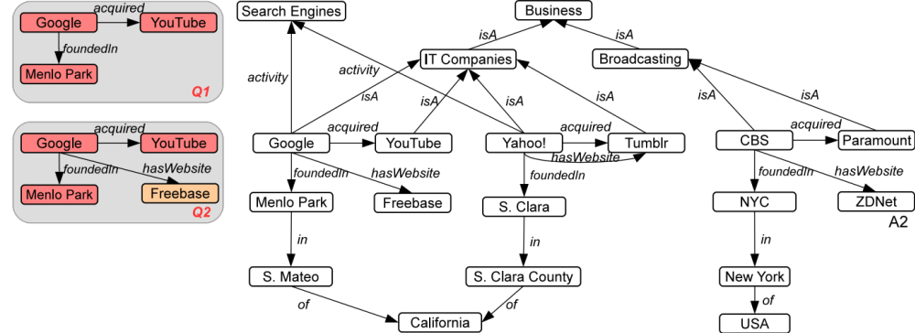
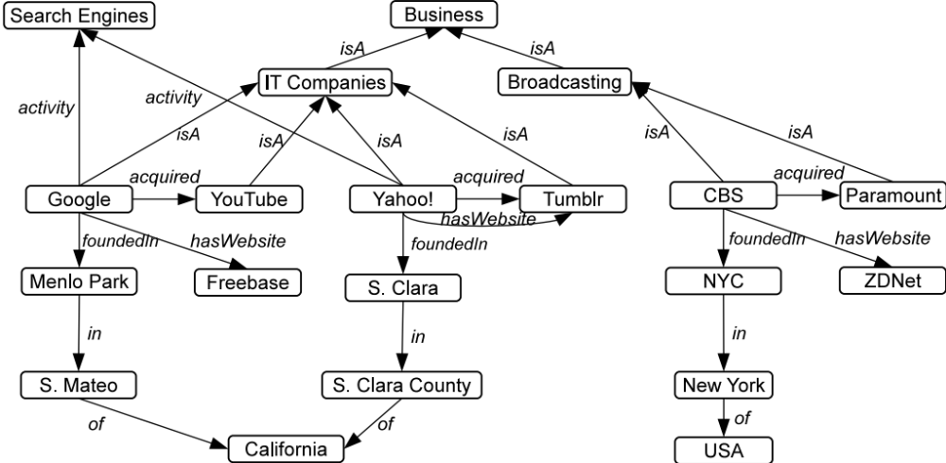
Exemplar Queries
Compute the answers using subgraph isomorphism
or strong simulation
S
A1
A2
Notes:
Q1, Q2 are user queries

Slide 37
Computing exemplar queries
NP-complete
(subgraph isomorphism)
$O\left({\left|V\right|}^{4}\right)$(simulation)
Pruning technique:
Compute the neighbor labels of each node
Prune nodes not matching query nodes neighborhood labels
Apply the technique iteratively on the query nodes
v
A
A
A
  $$W_{n,a,i}=\left\{n_{1} | l\left(n_{1},n_{2}\right)=a∨∈N_{i−1}\left(n\right)\right\}$$
X
B
B
B
A
u
Q
Sample
A1
B
Labels at distance 1
A2
G
v neighborhood = {(B,1)}
$⊈$
u neighborhood = {(A,1)}
No Match
Mottin, D., Lissandrini, M., Velegrakis, Y. and Palpanas, T. Exemplar queries: Give me an example of what you need. PVLDB 2014

Slide 38
Graph query by example (GQBE)
In GQBE Input is a set of (disconnected) entity mention tuples
Q = (Google, S. Mateo)
Results =
(Yahoo, S. Clara)
(CBS, New York)
Jayaram, N., Khan, A., Li, C., Yan, X. and Elmasri, R. Querying knowledge graphs by example entity tuples. TKDE, 2015

Slide 39
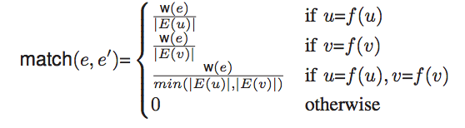
GQBE
NP-hard
Q = (v₁,v₂)
Find the maximum query graph
  Neighborhood Graph with m edges having the maximum weight
Find all the answers subgraph isomorphic to the query graph
Rank the answers and return the top-k tuples
0.1
0.1
0.2
z
v₁
u₂
0.4
0.7
0.1
0.8
0.5
0.3
Answer score:
Sum of query graph weights
Similarity match between edges in the answer and the query
v₂
u₁
0.5
Maximum Query Graph
Answer graph
Jayaram, N., Khan, A., Li, C., Yan, X. and Elmasri, R. Querying knowledge graphs by example entity tuples. TKDE, 2015

Slide 40
We are here
Background (5 min)
Graph models, subgraph isomorphism, subgraph mining, graph clustering
Exploratory Graph Analysis (20 min)
Focused Graph Mining (20 min)
Refinement of Query Results (20 min)
Challenges and discussion

Slide 41
Graph Mining – a very broad topic
Link Prediction
Community Detection
Anomaly Detection
Frequent Subgraph Mining
Graph Partitioning
… many more …

Slide 42
Graph Mining Focused on User Interest
  We consider “user interest” as a major tool for adaptive graph mining
  In contrast to raw analysis of graphs
  (i.e. with no or very little user interaction)
  Example (modularity based clustering):
Given a graph
discover best partitioning of the nodes
Optimize a given quality criterion Q(C),
e.g. Modularity or other measures
  Where is the user interest in such definitions?
  How to include the user into the loop?
  How do we need to change the algorithmic search?
a
a
a
a

Slide 43
Focus: Given a Set of Query Nodes
Given Q nodes (by the user)
How can we find the center-piece node
that has direct or indirect connections
to all or most of these nodes?
Neither a clustering of nodes
Nor the shortest path between pairs of nodes
Nor any other graph mining method (with lack of user input)
H. Tong & C. Faloutsos: Center-Piece Subgraphs: Problem Definition and Fast Solutions. (KDD 2006)

Slide 44
Focused Communities:
Given a Set of Seed Nodes
Traditional detection of communities
as internally dense subgraphs
(e.g. measured by modularity or conductance)
Given seed nodes (by the user)
Perform selective search for communities
local community detection
seed set expansion
Global search is not appropriate for such local/selective models
Communities may overlap or coincide
C. Staudt, Y. Marrakchi, H. Meyerhenke: Detecting Communities Around Seed Nodes in Complex Networks (BigData 2014)

Slide 45
Egoistic Focus on Yourself: Ego-Nets
For a given node
consider their neighbors and
the connections among these neighbors
Compute ego-nets for each given node that is of interest.
Useful for link prediction, community detection, anomaly detection, and many more, as pre-processing (feature extraction).
Epasto et al. Ego-Net Community Mining Applied to Fried Suggestion. (VLDB 2015)

Slide 46
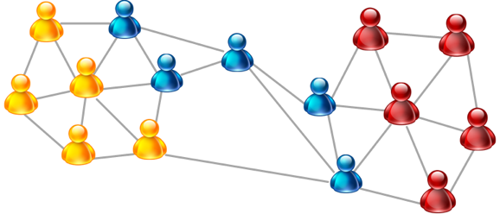
Mining Attributed Graphs
Different graph mining techniques
  Clustering / graph partitioning / …
  Community detection and anomaly detection
Used assumption: Homophily
has to be fulfilled for all the attributes
Problem: disassortative mixing [Newman 2003]
hinders the detection of communities
(i.e. similarity assessment of nodes)
age
Solution: Selection of relevant views ensuring homophily
Newman. Mixing patterns in networks. Physical Review, 2003

Slide 47
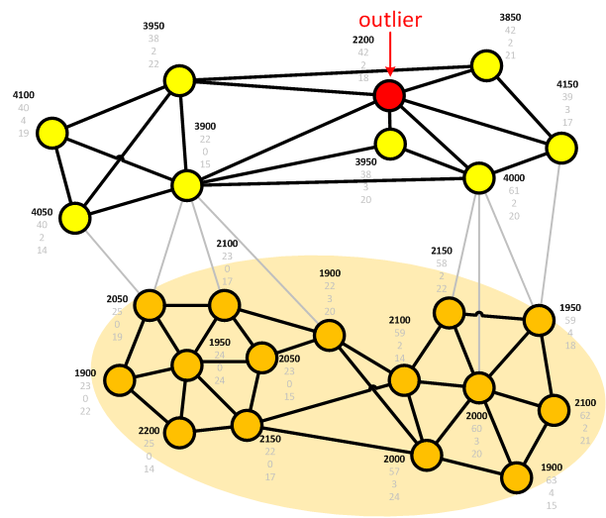

Multiple Views in Attributed Graphs
Different structures depending on the subset of attributes
age
income
shoe size
#children
...

Slide 48
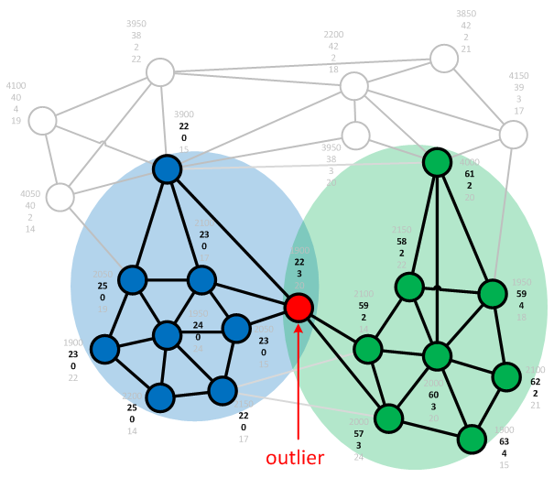
Multiple Views in Attributed Graphs
Different structures depending on the subset of attributes
age
income
shoe size
#children
...

Slide 49
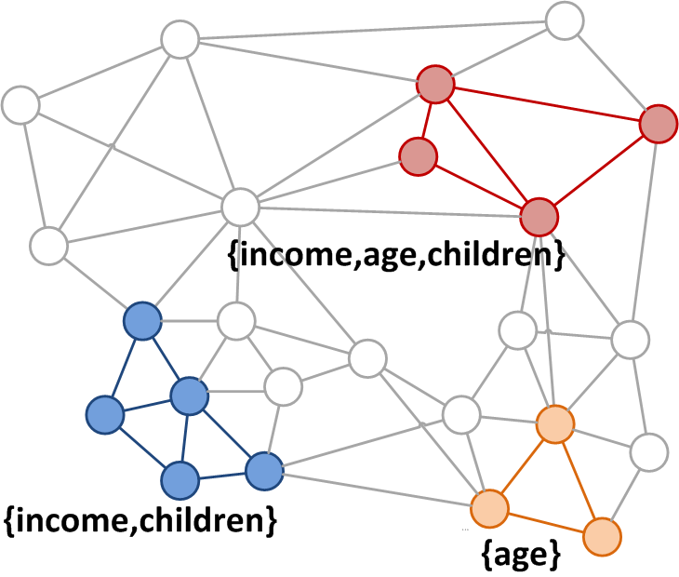
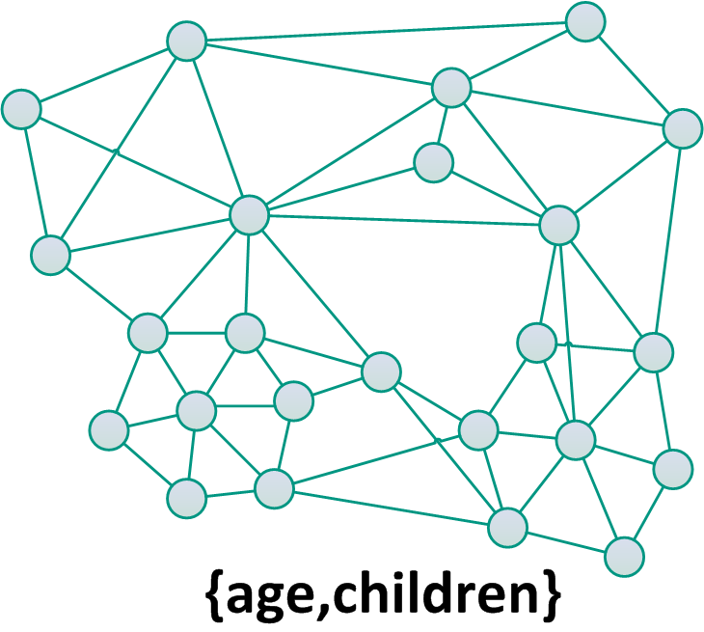
Specialized Approaches
Frequent subgraph mining, subspace clustering ...
  Local selection of the attributes
  Individual subgraphs

Slide 50
First Idea: Local Context Selection
Local Context:
  Subset of relevant attributes
  Selection w.r.t. a subgraph
How to define a local context
for each node?
How to efficiently select only
the relevant attributes?
Model dependent solution for community outlier mining
  Statistical test of attribute value distribution for each local context
  Measure deviation of each node w.r.t. its local context only
Iglesias et al. Local Context Selection for Outlier Ranking in Graphs with Multiple Numeric Node Attributes (SSDBM 2014)

Slide 51
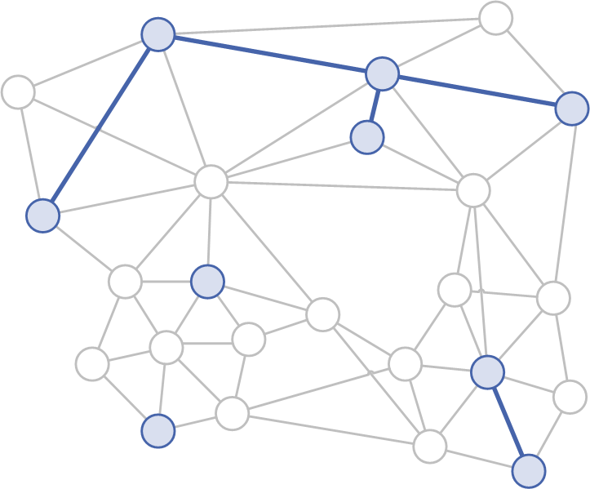
Selection of Congruent Subspaces (ConSub)
Definition: Congruent subspaces
  Mutual similarity between attribute values in subspace S
  Significantly more edges than expected by a random distribution
Constraint Subgraph $G_{C,S}$
  Set of constraints formed by all the pairs $(I_{j}=[low_{j},high_{j}], A_{j}∈S)$
S = {shoe size}
nodes with 8 ≤ shoe size ≤ 9
small number of edges
Iglesias et al. Statistical Selection of Congruent Subspaces for Mining Attributed Graphs (ICDM 2013)

Slide 52
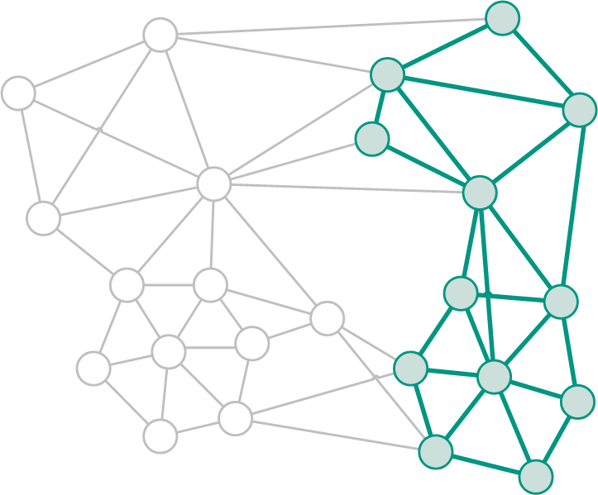
Selection of Congruent Subspaces (ConSub)
Definition: Congruent subspaces
  Mutual similarity between attribute values in subspace S
  Significantly more edges than expected by a random distribution
Constraint Subgraph $G_{C,S}$
  Set of constraints formed by all the pairs $(I_{j}=[low_{j},high_{j}], A_{j}∈S)$
S ={age,income}
nodes with 45 ≤ age ≤ 60 and
1900 ≤ income ≤ 4500
high number of edges
Iglesias et al. Statistical Selection of Congruent Subspaces for Mining Attributed Graphs (ICDM 2013)

Slide 53


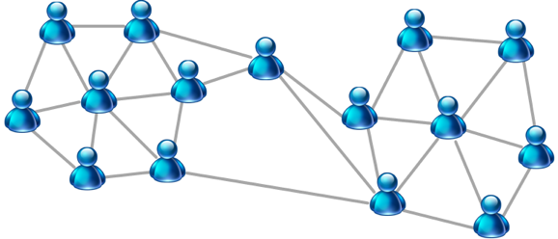

Focus on User Preference
Examples for user preference:
  attribute weighting
  examples of similar nodes
  some notion of similarity
age
income
shoe size
#children
...
examples of similar nodes
attribute weighting

Slide 54
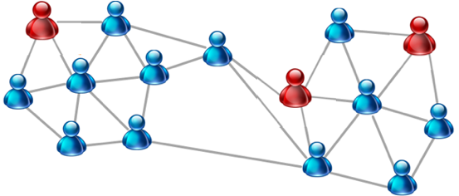
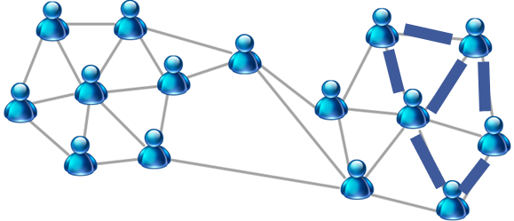
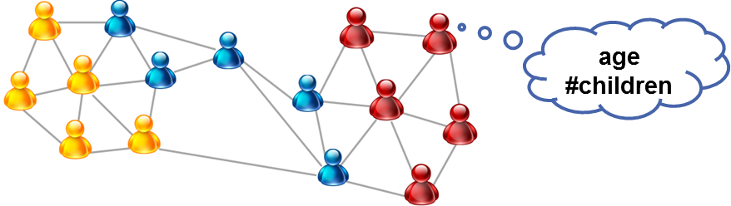
Focused Selection of Subsaces (FocusCO)
Decoupled mining for given user preference
  Infer similarity measure
  Re-weighting of graph edges
  Community detection & community outlier mining
(1)
(2)
  (3) applicable for various
  community detection models
Perozzi et al. Focused Clustering and Outlier Detection in Large Attributed Graphs (KDD 2014)

Slide 55
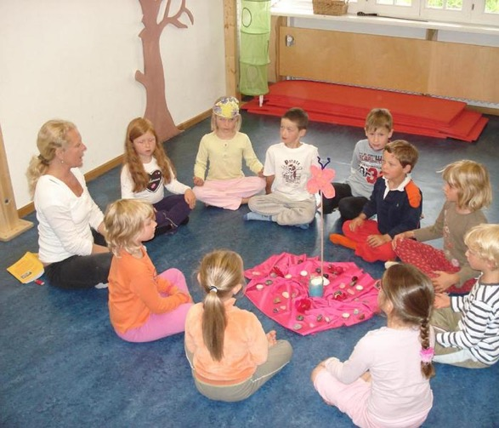
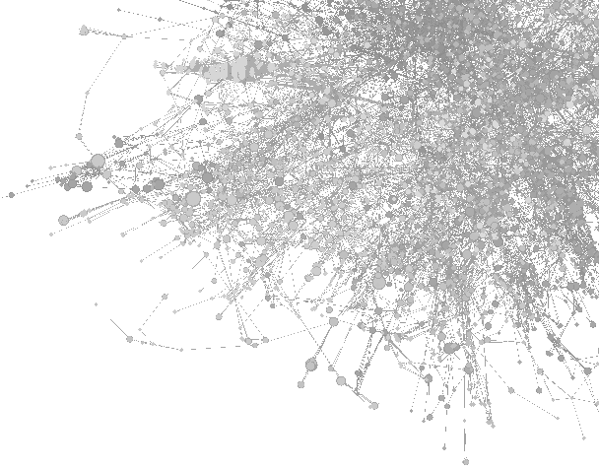
Knowledge Discovery by Focused Graph Mining
Example Sociology:
hypothesis testing vs. hypothesis generation

Slide 56
We are here
Background (5 min)
Graph models, subgraph isomorphism, subgraph mining, graph clustering
Exploratory Graph Analysis (20 min)
Focused Graph Mining (20 min)
Refinement of Query Results (20 min)
Challenges and discussion

Slide 57
Refinement of Graph Query Results
Reformulation and Refinement
Generate reformulations (explanations) for query with too-many too few results
Explain results by providing summaries
User perspective: even if the query is imprecise the system provides assistance
Top-k results
Use user feedback to find the k results with the highest score
User perspective: the results are potentially the most preferred items
Skyline queries
Not in this tutorial ☹
Optimize one single objective at a time when finding results of a query
User perspective: show only those nodes/graphs that are no worse than others

Slide 58
Reformulation and Refinement
The user query is too restrictive (few results) or too generic (many results)
Query (a graph)
Solution
Change the query to include more/less results
OR
Summarize the results
Query Reformulation approaches: in Graph Databases (Mottin et al.), in connected networks (Vasilyeva et al.)
Result summarization approaches: top-k representative (Ranu et al.), keyword induced result summarization (Wu et al.)

Slide 59





Graph Query Reformulation
Query
Results
Reformulations:
query
supergraphs
Exponential number
of reformulations
…
Mottin, D., Bonchi, F. and Gullo, F. Graph Query Reformulation with Diversity. KDD, 2015

Slide 60
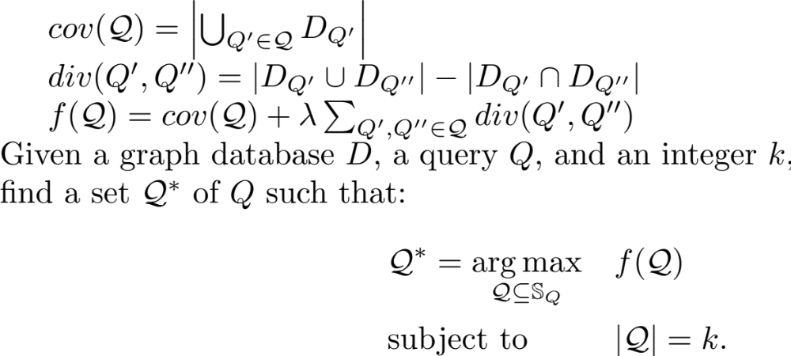




Graph Query Reformulation
Query
Results
Find k meaningful reformulations:
Span all the results
Present different aspects of the results
?
Coverage
Diversity
Mottin, D., Bonchi, F. and Gullo, F. Graph Query Reformulation with Diversity. KDD, 2015

Slide 61
Why empty, Why so-many answers in graphs
Query
Too Many answers
Query
Empty-answer
Problem
Given a query Q and a graph G, restrict/enlarge the result set with minimal changes in the query.
Large graph
Vasilyeva, E., Thiele, M., Bornhövd, C. and Lehner, W.. Answering “Why Empty?” and “Why So Many?” queries in graph databases. JCSS, 2016

Slide 62
Why empty, Why so-many answers in graphs
Why?
Empty/Too Many
Explanations
+
Graphs and unexpected subgraphs
Change the query
Maximum Common Subgraph
Differential
graph
Exponential
variations!
Modifications
Answers to the new queries
Vasilyeva, E., Thiele, M., Bornhövd, C. and Lehner, W.. Answering “Why Empty?” and “Why So Many?” queries in graph databases. JCSS, 2016

Slide 63
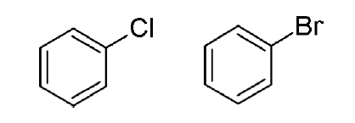
Top-k representative queries
Graphs are points in a metric space with d as a distance function
Select k=2 relevant objects
Top-2 answer: g₁, g₂
g₄
g₃
g₂
g₁
Redundant
Object is relevant
Object is non-relevant
Two objects are close if they are similar
Ranu, S., Hoang, M. and Singh, A. Answering top-k representative queries on graph databases. SIGMOD, 2014

Slide 64
Top-k representative queries
Result of
a query
$$G_{1}$$
$$G_{2}$$
$$G_{3}$$
$$G_{4}$$
$$G_{5}$$
Vector graph ${\vec{g}}_{i}$: vectorial representation of $G_{i}$
Example: Binding compatibility with m proteins, frequent subgraphs, belonged communities
Query: function from $\vec{g}$ to [-1,1], $q:\vec{g}→\left[−1,1\right]$
Example: Molecules with some properties, graphs with some structure, some community
Top-k Representative queries:
$$A=\text{arg} \max_{S}\left\{π_{θ}\left(S\right)\right|S⊆R\left(q\right), \left|S\right|=k\}$$
where $R\left(q\right)$ = results of q, $π_{θ}\left(S\right)$=representative power of S, given threshold $θ$
Ranu, S., Hoang, M. and Singh, A. Answering top-k representative queries on graph databases. SIGMOD, 2014

Slide 65
Representative power
R(q) = answers to the query
  q : query
$θ$-neighborhood
  $N_{θ}\left(G\right)=\left\{G^{′}∈R\left(q\right)\right|d\left(G,G^{′}\right)≤θ\}$
  $θ:$distance threshold
  $d(G,G′)$: graph edit distance
Given a set of graphs S
  Representative power of S
  $π_{θ}\left(S\right)= \frac{\left|\bigcup_{G∈S}{N_{θ}(G)}\right|}{R(q)}$
G₄
$$Θ$$
G₃
G₂
$$Θ$$
G₁
$$π\left(\left\{G1,G3\right\}\right)=\frac{7}{8}$$
Represent the coverage of a graph neighborhood
$$π\left(\left\{G1,G2\right\}\right)=\frac{4}{8}$$
Ranu, S., Hoang, M. and Singh, A. Answering top-k representative queries on graph databases. SIGMOD, 2014

Slide 66







Summarizing graph results
Query: keyword query on graph
e.g., Jaguar, America, History
Jaguar XK 001
Jaguar XK 007
Jaguar XJ
Jaguar S type
…
_{Offer 1}
… Offer m
Ford, company
… Aspen, company
New York, city
…Chicago, city
New York, city
…Chicago, city
history
USA, country
USA, country
…
Black Jaguar
animal
White Jaguar
animal
South American Jaguars
history
history
habitat
history
Argentina
South America
continent
North America
continent
South America
continent
Wu, Y., Yang, S., Srivatsa, M., Iyengar, A. and Yan, X. Summarizing answer graphs induced by keyword queries. PVLDB, 2013

Slide 67
Summarizing graph results
Q = {a,b,c}
Answer graph: keyword nodes and intermediate nodes
Summary graph Gs:
Preserve connections between keyword nodes
Each node is a hypernode
For any path in Gs there is a path in the union of answer graphs with the same label
a
a
Keyword node
a
Intermediatenode
c
c
Quality of a summary (coverage)
$α=2∗M/(\left|Q\right|\left(\left|Q\right|−1\right)$,
M = number of covered keyword pairs
b
b
Answer graph
Summary graph
Two problems
Minimum $α$-summarization: find the minimum size summary which covers at least $α$
K-summarization: find K 1-summaries with minimum total size that form a K-partition on the answer graph sets (no repeated answers)
Wu, Y., Yang, S., Srivatsa, M., Iyengar, A. and Yan, X. Summarizing answer graphs induced by keyword queries. PVLDB, 2013

Slide 68
Summarizing graph results
Q = {a,c,e,f,g}
G1
a1*
a2*
G2
a3*
G3
a4*
b1
b2
d1
d2
d3
d4
d5
d6
…
d7
d8
d9
f1*
c1*
e1*
e1*
e2*
g1*
e3*
g2*
(‘a, c’), {G1, G2}
(‘a, e, g’), {G1, G2}
(‘a, e, g’), {G3}
a*
a*
a*
b
d
d
d
d
c*
e*
g*
e*
g*
0.1-summary Gs1
0.3-summary Gs2
1-summary Gs3

Slide 69
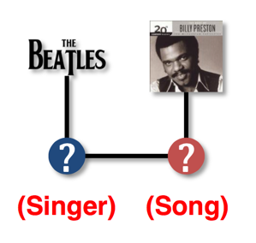
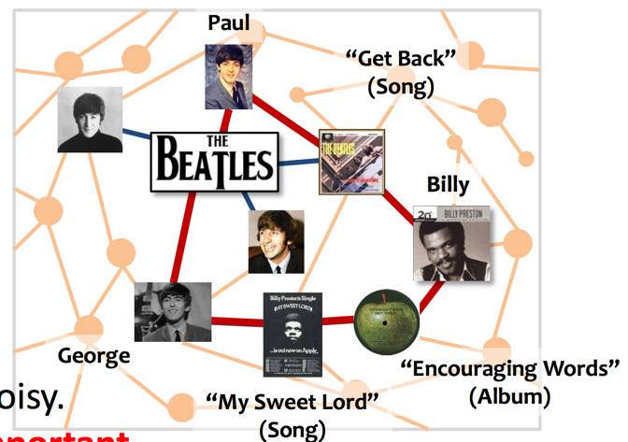
Top-k Results
Large query results
Find interesting exact and similar matches
Solution
Query
Graph
Ranking the results
Optionally diversifying the matching
Diversified top-k graph pattern matching (Fan et al.)
Exploiting relevance feedback in knowledge graph search (Su et al.)
Top-k interesting subgraph discovery in information networks (Gupta et al.)
Querying web-scale information networks through bounding matching scores (Jin et al.)

Slide 70
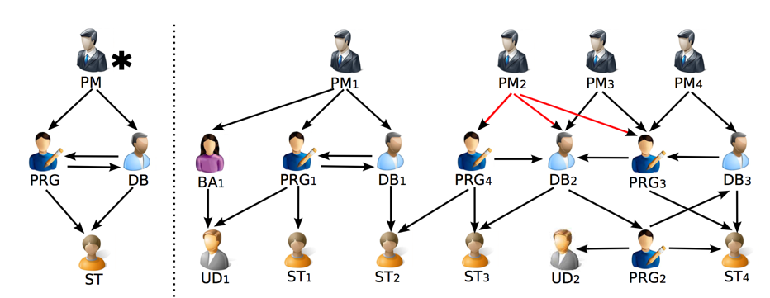
Diversified top-k graph pattern matching
Query:
Find good PM (project manager) candidates collaborated with PRG (programmer), DB (database developer) and ST (software tester).
Pattern Q
Graph G
When graph pattern matching is defined in terms of subgraph isomorphism, no match of Q can be identified in G (too restrictive to define matches as isomorphic subgraphs)
Find matches using graph simulation, which computes a binary relation on the pattern nodes in Q and their matches in G
Fan, W., Wang, X. and Wu, Y. Diversified top-k graph pattern matching. VLDB, 2013

Slide 71
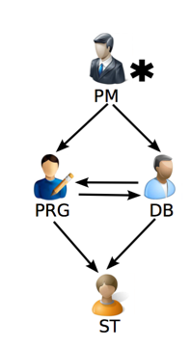
Diversified top-k graph pattern matching
  Graph pattern matching revised
    extend a pattern with a designated output node u₀
    matches Q(G): the matches of u₀
    readily extends to multiple output nodes
  Problem:
    Find (diversified) top-K matches for graph pattern matching with a designated output node.
Pattern Q
Fan, W., Wang, X. and Wu, Y. Diversified top-k graph pattern matching. VLDB, 2013

Slide 72





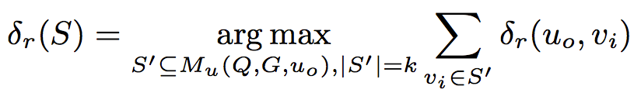
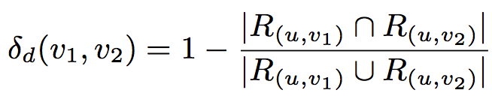

Diversified top-k graph pattern matching
  Relevance
    Relevant set R(u,v) for a match v of a query node u:
    all descendants of v as matches of descendants of u
  Relevance function
      The more reachable matches, the better
  Top-k matching, k-match maximizing
PM₂
PRG₄
DB₂
PRG₃
DB₃
ST₂
ST₃
PRG₂
ST₄
Pattern Q
Relevance
Diversity
Fan, W., Wang, X. and Wu, Y. Diversified top-k graph pattern matching. VLDB, 2013

Slide 73









Finding Top-k Matches (acyclic)
Project
Manager*
PM₁
PM₂
PM₃
PM₄
PRG₁
DB₁
PRG₄
DB₂
PRG₃
DB₃
BA
Starting propagation from DB2, after propagation, parts of the vectors are as below.
After initialization, vectors of parts nodes.
Programmer
DB manager
UD₁
ST₁
ST₂
ST₃
UD₂
PRG₂
ST₄
v | v.T = <v.bf, v.R, v.l, v.h>
PM1 | <XPM1 = XPRG1 ˄ XDB1, Ф, 0, 2>
PM2 | <XPM2 = ((XPRG3 =true) V (XPRG4=true)) ˄ XDB2=true, {DB2, PRG4, PRG3}, 3, 3>
PM3 | <XPM3 = (XPRG3 = true) ˄ (XDB2=true), {DB2, PRG3}, 2, 2>
PM4 | <XPM4 = (XPRG3 = true) ˄ XDB3, Ф, 0, 2>
PRG1 | <XPRG1 = XDB1, Ф, 0, 1>
PRGj (j ∈ [3,4]) | <XPRGj = true, {DB2}, 1, 1>
DB2 | <XDB2 = true, Ф, 0, 0>
DBk (k ∈ [1,3]) | <XDBk = true, Ф, 0, 0>
v | v.T = <v.bf, v.R, v.l, v.h>
PM1 | <XPM1 = XPRG1 ˄ XDB1, Ф, 0, 2>
PM2 | <XPM2 = (XPRG3 V XPRG4) ˄ XDB2, Ф, 0, 3>
PM3 | <XPM3 = XPRG3 ˄ XDB2, Ф, 0, 2>
PM4 | <XPM4 = XPRG3 ˄ XDB3, Ф, 0, 2>
PRG1 | <XPRG1 = XDB1, Ф, 0, 1>
PRGj (j ∈ [3,4]) | <XPRGj = XDB2, Ф, 0, 1>
DBk (k ∈ [1,3]) | <XDBk = true, Ф, 0, 0>
PM2 is verified to be a valid match, and its relevant set includes {DB2, PRG4, PRG3}, which is the largest relevant set compared with other PMs.
Early termination condition is met.
Notes:
2-approximable algorithm:
1) Compute all the matches, δr() and δd();
2) Iteratively find two matches v1, v2,
such that F’(v1, v2) is maximized;
If k is odd, then in the last round, we randomly pick a match

Slide 74
We are here
Background (5 min)
Graph models, subgraph isomorphism, subgraph mining, graph clustering
Exploratory Graph Analysis (20 min)
Focused Graph Mining (20 min)
Refinement of Query Results (20 min)
Challenges and discussion

Slide 75
Summary of Exploratory Graph Analysis
Approximate Queries
User query is imprecise
By-Example methods
User query is an example result
Only need a partial knowledge on the data
No need for complicate query languages (use examples, partial descriptions)
The query adapts to user need
Enable exploratory search by using small queries on the data
?
Query
(an example)
Query (a graph)
Graph
Graph

Slide 76
Challenges for Exploratory Graph Analysis
Database
Unsupported in most of the current graph databases
No ”universal” index to answer multiple type of queries
Partitioning methods for approximate query answering
User interactivity in the exploration process
No solutions for probabilistic graphs
Respond to queries in dynamic graphs
Find examples in streaming settings
Data mining
Information retrieval
Exploiting query logs for personalized query answering
Retrieve results in form of documents converting the query structures
Information retrieval

Slide 77
Summary of Focused Graph Mining
The focus on individual user interest
… as Query to the Graph Mining System
… as Seed Node(s) for Local Search
… as Attributes and Weights
get or infer user interest
→ unexpected results
interactive exploration
→ intuitive parametrization
adaptive graph mining
→ individual local search

Slide 78
Challenges for Focused Graph Mining
User interactivity in the graph mining process
unsupported in most of the current graph mining algorithms
huge variety of user interactions possible
feedback loop needs to be unified and become exchangeable
Revolution of formal models and search algorithms
insufficient extensions of existing models and algorithms
adaptive steering of algorithms vs. fixed parametrization
evaluation of algorithms with user studies
Data mining
scale
Scalability of algorithms for real-time interaction
NP-hard problems, heuristic algorithms, …, still not scalable
exploit the user interest for pruning the search space

Slide 79




Summary of Refinement of Query Results
Refinement
The user query is too restrictive or too generic
Top-k Results
Queries typically have inexact matches
Skyline Queries
Find small set of interesting items with many dimensions and incremental updates
The user might have a very generic idea of how to describe the structure of interest
The system guides the user towards the answer with simple steps
The results are explained with reformulations
The queries can be inexact
79

Slide 80
Challenges for Refinement of Query Results
Database
Profiling of queries for optimized performance
Provenance and explainability of queries
Managing uncertainty in data
Personalized reformulations and interactivity
Facet search discovery in graphs
Learning of user preferences while refining
Data mining
Real time performance not achieved
Avoiding traverse the entire space using query workloads and query logs
scale

Slide 81
The missing tiles in graph exploration
Interactivity
Adaptivity
Personalization
Scalability

Slide 82
Slides: https://hpi.de//mueller/tutorials/graph-exploration-sigmod.html

Slide 83
References
[Ma14] Ma, S., Cao, Y., Fan, W., Huai, J. and Wo, T. Strong simulation: Capturing topology in graph pattern matching. TODS, 2014
[Fan10] Fan, W., Li, J., Ma, S., Wang, H. and Wu, Y.. Graph homomorphism revisited for graph matching. PVLDB, 2010
[Khan13] Khan, A., Wu, Y., Aggarwal, C.C. and Yan, X. Nema: Fast graph search with label similarity. PVLDB, 2013
[Yang14] Yang, S., Wu, Y., Sun, H. and Yan, X. Schemaless and structureless graph querying. PVLDB, 2014.
[Mottin14] Mottin, D., Lissandrini, M., Velegrakis, Y. and Palpanas, T. Exemplar queries: Give me an example of what you need. PVLDB 2014
[Jayaram15] Jayaram, N., Khan, A., Li, C., Yan, X. and Elmasri, R. Querying knowledge graphs by example entity tuples. TKDE, 2015

Slide 84
References
[Tong06] H. Tong & C. Faloutsos: Center-Piece Subgraphs: Problem Definition and Fast Solutions. (KDD 2006)
[Staudt14] C. Staudt, Y. Marrakchi, H. Meyerhenke: Detecting Communities Around Seed Nodes in Complex Networks (BigData 2014)
[Epasto15] Epasto et al. Ego-Net Community Mining Applied to Fried Suggestion. (VLDB 2015)
[Iglesias14] Iglesias et al. Local Context Selection for Outlier Ranking in Graphs with Multiple Numeric Node Attributes (SSDBM 2014)
[Iglesias13] Iglesias et al. Statistical Selection of Congruent Subspaces for Mining Attributed Graphs (ICDM 2013)
[Perozzi14] Perozzi et al. Focused Clustering and Outlier Detection in Large Attributed Graphs (KDD 2014)

Slide 85
References
[Mottin15] Mottin, D., Bonchi, F. and Gullo, F. Graph Query Reformulation with Diversity. KDD, 2015
[Vasilyeva16] Vasilyeva, E., Thiele, M., Bornhövd, C. and Lehner, W.. Answering “Why Empty?” and “Why So Many?” queries in graph databases. JCSS, 2016
[Ranu14] Ranu, S., Hoang, M. and Singh, A. Answering top-k representative queries on graph databases. SIGMOD, 2014
[Wu13] Wu, Y., Yang, S., Srivatsa, M., Iyengar, A. and Yan, X. Summarizing answer graphs induced by keyword queries. PVLDB, 2013
[Fan13] Fan, W., Wang, X. and Wu, Y. Diversified top-k graph pattern matching. VLDB, 2013
[Gupta14] Gupta, M., Gao, J., Yan, X., Cam, H. and Han, J. Top-k interesting subgraph discovery in information networks. ICDE, 2014
[Zou10] Zou, L., Chen, L., Özsu, M.T. and Zhao, D. Dynamic skyline queries in large graphs. DASFAA, 2010

