Slide 1
Communication Cost in Parallel Query Processing
Dan Suciu
University of Washington
Based on joint work w/ith
Paul Beame, Paris Koutris
Beame, Koutris, S. PODS’2013
Beame, Koutris, S. PODS’2014
Balazinska, Chu, S. SIGMOD’2015
Beame, Koutris, S. ICDT’2016

Slide 2
This Talk
How much communication is needed to compute a query Q on p servers?
Gamma, MapReduce, Hive, Teradata, Aster Data, Spark, Impala, Myria, Tensorflow

Slide 3
Massively Parallel Communication Model (MPC)
Extends BSP [Valiant]
Input (size=m)
Input data = size m
O(m/p)
O(m/p)
Server 1
. . . .
Server p
Number of servers = p
Notes:
Say: in algorithms, L = maximum load. In lower bounds, L = average load

Slide 4
Massively Parallel Communication Model (MPC)
Extends BSP [Valiant]
Input (size=m)
Input data = size m
O(m/p)
O(m/p)
Server 1
. . . .
Server p
Number of servers = p
≤L
≤L
Round 1
One round = Compute & communicate
Server 1
. . . .
Server p
Notes:
Say: in algorithms, L = maximum load. In lower bounds, L = average load

Slide 5
Massively Parallel Communication Model (MPC)
Extends BSP [Valiant]
Input (size=m)
Input data = size m
O(m/p)
O(m/p)
Server 1
. . . .
Server p
Number of servers = p
≤L
≤L
Round 1
One round = Compute & communicate
Server 1
. . . .
Server p
≤L
≤L
Round 2
Algorithm = Several rounds
Server 1
. . . .
Server p
≤L
≤L
Round 3
. . . .
. . . .
Notes:
Say: in algorithms, L = maximum load. In lower bounds, L = average load

Slide 6
Massively Parallel Communication Model (MPC)
Extends BSP [Valiant]
Input (size=m)
Input data = size m
O(m/p)
O(m/p)
Server 1
. . . .
Server p
Number of servers = p
≤L
≤L
Round 1
One round = Compute & communicate
Server 1
. . . .
Server p
≤L
≤L
Round 2
Algorithm = Several rounds
Server 1
. . . .
Server p
Max communication load / round / server = L
≤L
≤L
Round 3
. . . .
. . . .
Notes:
Say: in algorithms, L = maximum load. In lower bounds, L = average load

Slide 7
Massively Parallel Communication Model (MPC)
Extends BSP [Valiant]
Input (size=m)
Input data = size m
O(m/p)
O(m/p)
Server 1
. . . .
Server p
Number of servers = p
≤L
≤L
Round 1
One round = Compute & communicate
Server 1
. . . .
Server p
≤L
≤L
Round 2
Algorithm = Several rounds
Server 1
. . . .
Server p
Max communication load / round / server = L
≤L
≤L
Round 3
. . . .
. . . .
Cost: | Ideal | Practical ε∈(0,1) | Naïve 1 | Naïve 2
Load L | L = m/p | L = m/p^{1-ε} | L = m | L = m/p
Rounds r | 1 | O(1) | 1 | p
Notes:
Say: in algorithms, L = maximum load. In lower bounds, L = average load

Slide 8
Massively Parallel Communication Model (MPC)
Extends BSP [Valiant]
Input (size=m)
Input data = size m
O(m/p)
O(m/p)
Server 1
. . . .
Server p
Number of servers = p
≤L
≤L
Round 1
One round = Compute & communicate
Server 1
. . . .
Server p
≤L
≤L
Round 2
Algorithm = Several rounds
Server 1
. . . .
Server p
Max communication load / round / server = L
≤L
≤L
Round 3
. . . .
. . . .
Cost: | Ideal | Practical ε∈(0,1) | Naïve 1 | Naïve 2
Load L | L = m/p | L = m/p^{1-ε} | L = m | L = m/p
Rounds r | 1 | O(1) | 1 | p
Notes:
Say: in algorithms, L = maximum load. In lower bounds, L = average load

Slide 9
Massively Parallel Communication Model (MPC)
Extends BSP [Valiant]
Input (size=m)
Input data = size m
O(m/p)
O(m/p)
Server 1
. . . .
Server p
Number of servers = p
≤L
≤L
Round 1
One round = Compute & communicate
Server 1
. . . .
Server p
≤L
≤L
Round 2
Algorithm = Several rounds
Server 1
. . . .
Server p
Max communication load / round / server = L
≤L
≤L
Round 3
. . . .
. . . .
Cost: | Ideal | Practical ε∈(0,1) | Naïve 1 | Naïve 2
Load L | L = m/p | L = m/p^{1-ε} | L = m | L = m/p
Rounds r | 1 | O(1) | 1 | p
Notes:
Say: in algorithms, L = maximum load. In lower bounds, L = average load

Slide 10
Massively Parallel Communication Model (MPC)
Extends BSP [Valiant]
Input (size=m)
Input data = size m
O(m/p)
O(m/p)
Server 1
. . . .
Server p
Number of servers = p
≤L
≤L
Round 1
One round = Compute & communicate
Server 1
. . . .
Server p
≤L
≤L
Round 2
Algorithm = Several rounds
Server 1
. . . .
Server p
Max communication load / round / server = L
≤L
≤L
Round 3
. . . .
. . . .
Cost: | Ideal | Practical ε∈(0,1) | Naïve 1 | Naïve 2
Load L | L = m/p | L = m/p^{1-ε} | L = m | L = m/p
Rounds r | 1 | O(1) | 1 | p
Notes:
Say: in algorithms, L = maximum load. In lower bounds, L = average load

Slide 11
Massively Parallel Communication Model (MPC)
Extends BSP [Valiant]
Input (size=m)
Input data = size m
O(m/p)
O(m/p)
Server 1
. . . .
Server p
Number of servers = p
≤L
≤L
Round 1
One round = Compute & communicate
Server 1
. . . .
Server p
≤L
≤L
Round 2
Algorithm = Several rounds
Server 1
. . . .
Server p
Max communication load / round / server = L
≤L
≤L
Round 3
. . . .
. . . .
Cost: | Ideal | Practical ε∈(0,1) | Naïve 1 | Naïve 2
Load L | L = m/p | L = m/p^{1-ε} | L = m | L = m/p
Rounds r | 1 | O(1) | 1 | p
Notes:
Say: in algorithms, L = maximum load. In lower bounds, L = average load

Slide 12
Notations
Query: Full CQ blue
Data: |S₁| = m₁, |S₂| = m₂,...
Domain size: n
Servers: p red
Load: L = f_{Q}(m, p)

Slide 13
Speedup
Speed
L = m/p
Linear speedup
L = m/p^{1-ε}
Sub-linear speedup
# processors (=p)

Slide 14
Outline
Takeaway
Load f(τ*), even w/o skew
Basic Query Processing.
Unequal Inputs
Skew
Multiple rounds
Open Problems
Load: max over
edge packing polytope
Necessarily worse load
Load f(ρ*), due to skew

Slide 15
Basic Query Processing

Slide 16
Hash Join
Join(x,y,z) = R(x,y) ∧ S(y,z)
|R| = |S| = m tuples
|R|=|S|=m
O(m/p)
O(m/p)
Server 1
. . . .
Server p
R
x | y
a | b
a | c
b | c
S
y | z
b | d
b | e
c | e
Server 1
. . . .
Server p
R(x,y) ⋈ S(y,z)
R(x,y) ⋈ S(y,z)
Round 1: each server
Sends record R(x,y) to server h(y) mod p
Sends record S(y,z) to server h(y) mod p
Output: each server
local join R(x,y) ⋈ S(y,z)
Assuming no skew
L = O(m/p) w.h.p.

Slide 17
The Triangles Query
Q(x,y,z) = R(x,y)∧S(y,z)∧T(z,x)
|R| = |S| = |T| = m tuples
Can compute in one round!
Algorithm introduced by [Afrati&Ullman’10]
  Named later Shares Algorithm
  For MapReduce
Analyzed/optimized [Beame’13,’14]
  HyperCube Algorithm
  For the MPC model

Slide 18
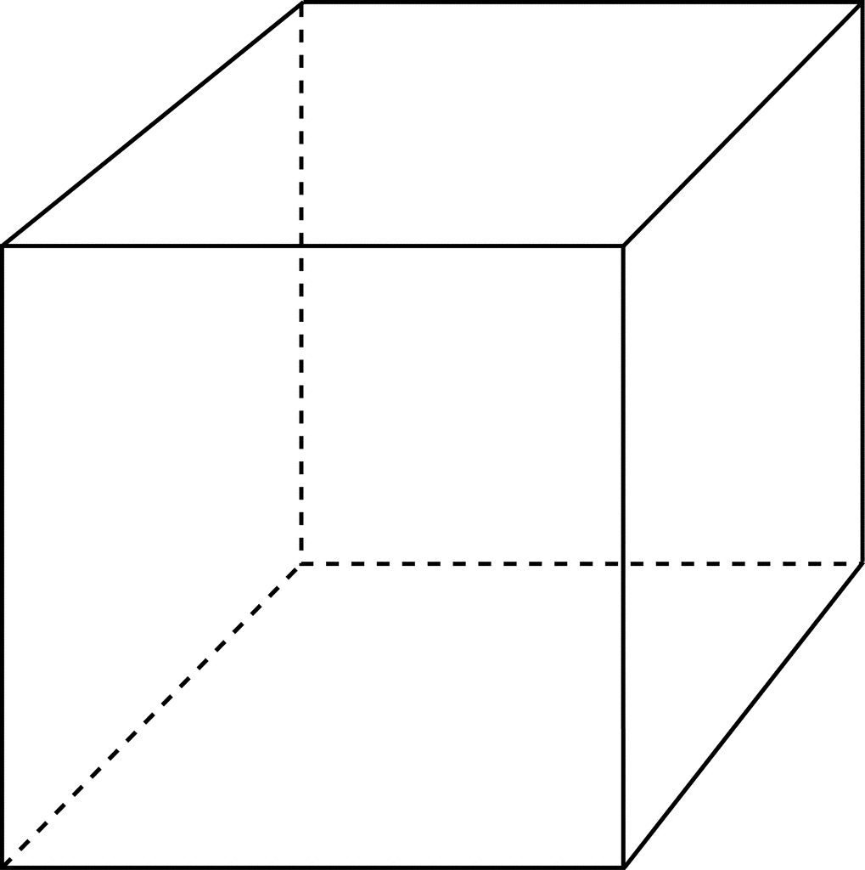
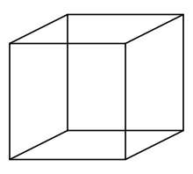
Triangles in One Round
Q(x,y,z) = R(x,y)∧S(y,z)∧T(z,x)
|R| = |S| = |T| = m tuples
Place servers in a cube p = p^{1/3} × p^{1/3} × p^{1/3}
Each server identified by (i,j,k)
Choose 3 random, independent hash functions:
h₁ : Dom → [p^{1/3}]
h₂ : Dom → [p^{1/3}]
h₃ : Dom → [p^{1/3}]
Server (i,j,k)
(i,j,k)
k
j
i
p^{1/3}

Slide 19
Triangles in One Round
Q(x,y,z) = R(x,y)∧S(y,z)∧T(z,x)
|R| = |S| = |T| = m tuples
T
Z | X
Fred | Alice
Jack | Jim
Fred | Jim
Carol | Alice
…
Round 1:
  Send R(x,y) to all servers (h₁(x),h₂(y),*)
  Send S(y,z) to all servers (*, h₂(y), h₃(z))
  Send T(z,x) to all servers (h₁(x), *, h₃(z))
Output:
compute locally R(x,y)∧S(y,z)∧T(z,x)
S
Y | Z
Fred | Alice
Jack | Jim
Fred | Jim
Carol | Alice
Jim | Jack
Jack | Jim
R
X | Y
Fred | Alice
Jack | Jim
Fred | Jim
Carol | Alice
…
Fred | Jim
Jim | Jack
Jim | Jack
Fred | Jim
(i,j,k)
Fred | Jim
Jim | Jack
Fred | Jim
Fred | Jim
Jim | Jack
Fred | Jim
Jack | Jim
Fred | Jim
k
Jack | Jim
j = h₁(Jim)
Jim | Jack
p^{1/3}
i = h₂(Fred)

Slide 20
Communication load per server
Q(x,y,z) = R(x,y)∧S(y,z)∧T(z,x)
|R| = |S| = |T| = m tuples
Theorem HyperCube has load L = O(m/p^{2/3})
w.h.p., on any input database without skew.
Can we compute Triangles with L = m/p?
Will prove
in the next
9 slides
No! [Beame’13]
Theorem Any 1-round algorithm has load
L = Ω(m/p^{2/3} ), even on inputs with no skew.

Slide 21
Proof Attempt
Q(x,y,z) = R(x,y)∧S(y,z)∧T(z,x)
|R| = |S| = |T| = m tuples
Find a worst case input database R, S, T,
prove that it requires load L = Ω(m/p^{2/3} )
Problem: for any input database there is a specialized encoding s.t. L = O(p) bits.
There is no “worst” database!
Theorem Any 1-round algorithm has load
L = Ω(m/p^{2/3} ), even on inputs with no skew.

Slide 22
Proof: Formal Statement
Q(x,y,z) = R(x,y)∧S(y,z)∧T(z,x)
|R| = |S| = |T| = n tuples
Inputs: R, S, T random permutations on [n]
R | x | y
 | 1 | 3
 | 2 | 1
 | 3 | 4
 | 4 | 2
Notation: L_{lower} = 3*log(n!) / p^{2/3}
size of the
input in bits
Theorem If A is a 1-round algorithm with load L
then E[ |A| ] ≤ ( L / L_{lower})^{3/2} E[ |Q| ]

Slide 23
Proof Outline
Q(x,y,z) = R(x,y)∧S(y,z)∧T(z,x)
|R| = |S| = |T| = n tuples
Step1: Compute E[ |Q| ]
Step2: Certain tuples E[ |K_{u}| ]
Step3: Answers returned E[ |A_{u}| ]
Theorem If A is a 1-round algorithm with load L
then E[ |A| ] ≤ ( L / L_{lower})^{3/2} E[ |Q| ]

Slide 24
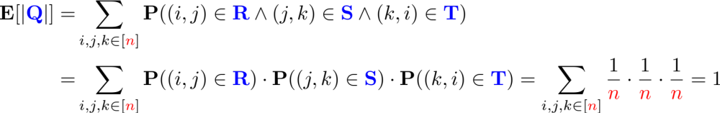
Step 1: E[ |Q| ]
Q(x,y,z) = R(x,y)∧S(y,z)∧T(z,x)
|R| = |S| = |T| = n tuples
Fact If are R, S, T are independent random
permutations, then E[|Q|] = 1
R | x | y
 | 1 | 3
 | 2 | 1
 | 3 | 4
 | 4 | 2
S | y | z
 | 1 | 4
 | 2 | 2
 | 3 | 1
 | 4 | 3
T | z | x
 | 1 | 1
 | 2 | 2
 | 3 | 3
 | 4 | 4
Q | x | y | z
 | 1 | 3 | 1
 | 3 | 4 | 3
E.g. n = 4
∧
∧
=
Proof
Notes:
\mathbf{E[|{\color{blue}Q}|]} = &
\sum_{i,j,k \in [{\color{red}n}]} \mathbf{P}((i,j) \in {\color{blue}\mathbf R} \wedge (j,k) \in {\color{blue}\mathbf S} \wedge (k,i) \in {\color{blue}\mathbf T})\\
= & \sum_{i,j,k \in [{\color{red}n}]} \mathbf{P}((i,j) \in {\color{blue}\mathbf R}) \cdot \mathbf{P}((j,k) \in {\color{blue}\mathbf S}) \cdot \mathbf{P}((k,i) \in {\color{blue}\mathbf T})
= \sum_{i,j,k \in [{\color{red}n}]} \frac{1}{\color{red}n} \cdot \frac{1}{\color{red}n} \cdot \frac{1}{\color{red}n} = 1
E[ |Triangles| ] = Σ_{i,j,k} P( (i,j) ∈ R ∧ (j,k) ∈ S ∧ (k,i) ∈ T )
= Σ_{i,j,k} P( (i,j) ∈ R ) * P((j,k) ∈ S ) * P( (k,i) ∈ T )
= Σ_{i,j,k} 1/n * 1/n * 1/n = n³ / n³ = 1

Slide 25
Step 2: Certain Tuples
Q(x,y,z) = R(x,y)∧S(y,z)∧T(z,x)
|R| = |S| = |T| = n tuples
A fixed server u receives three messages
msg₁(R) ∈ {0,1}^{L1} about R
msg₂(S) ∈ {0,1}^{L2} about S
msg₃(T) ∈ {0,1}^{L3} about T
L₁ + L₂ + L₃ ≤ L bits
Definition Given msg₁∈{0,1}^{L1}, the certain tuples are:
K₁(msg₁) = { (i,j) | ∀R, msg₁(R) = msg₁ → (i,j) ∈ R}
K₂(msg₂), K₃(msg₃) are the certain tuples in S, T

Slide 26
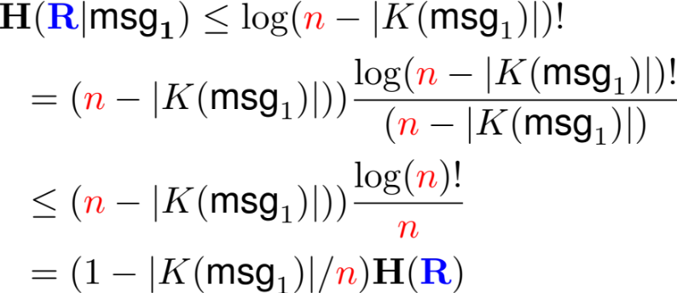
Step 2: Certain Tuples
Q(x,y,z) = R(x,y)∧S(y,z)∧T(z,x)
|R| = |S| = |T| = n tuples
H is the Entropy
H(R) = log(n!)
H(msg₁(R)) ≤ L₁
Let R = random permutation, |R|=n
Lemma. E[ |K(msg₁(R))| ] ≤ n * H(msg1(R)) / H(R)
Proof:
H(R) = H(R, msg₁(R))
= H(msg₁(R)) + H( R | msg₁(R))
= H(msg₁(R)) + E[ H(R | msg₁) ]
≤ H(msg₁(R)) + (1 – E[|K(msg₁)| ] / n ) * H(R)
1 ≤ H(msg1(R)) / H(R) + (1 – E[|K(msg₁(R))| ] / n )
E[ |K(msg₁(R))| ] ≤ n * H(msg1(R)) / H(R)
Notes:
& \mathbf{H({\color{blue}R}|\text{msg}_1)} \leq \log ({\color{red}n}-|K(\text{msg}_1)|)! \\
& \ \ = ({\color{red}n}-|K(\text{msg}_1)|)) \frac{\log ({\color{red}n}-|K(\text{msg}_1)|)!}{({\color{red}n}-|K(\text{msg}_1)|)}\\
& \ \ \leq ({\color{red}n}-|K(\text{msg}_1)|)) \frac{\log ({\color{red}n})!}{{\color{red}n}} \\
& \ \ = (1-|K(\text{msg}_1)|/{\color{red}n}) \mathbf{H({\color{blue}R})}

Slide 27
Background (1/2)
Hyper-graph: nodes x₁, …, x_{k}, edges S₁, …, S_{l}
Def. Fractional edge cover: u₁, u₂, … u_{l} ≥ 0 s.t. ∀ x_{i}: Σ_{j:xi∈Sj} u_{j} ≥ 1
Fractional vertex packing: v₁, v₂, … v_{k} ≥ 0 s.t. ∀S_{j}: Σ_{i:xi∈Sj} v_{i} ≤ 1
max_{v1,… vk} Σ_{i} v_{i} = min_{u1,… ul} Σ_{j} u_{j} = ρ*
Same ρ* as in
the AGM bound
Example: Q(x)=R(x),S(x) u₁=u₂=1/2 ρ* = 2
½
½
Example: Q(x,y,z)=R(x,y),S(y,z),T(z,x) u₁=u₂=u₃=1/2 ρ* = 3/2
½
Notes:
\mathbf{
{\color{blue}Q}(x_1, \ldots, x_k) =
{\color{blue}S_1}(\bar x_1) \wedge
{\color{blue}S_2}(\bar x_2) \wedge \cdots \wedge
{\color{blue}S_\ell}(\bar x_\ell)
}

Slide 28
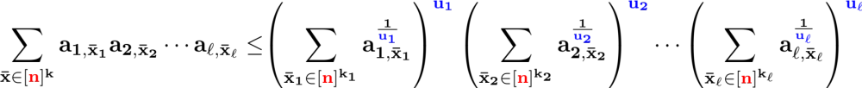
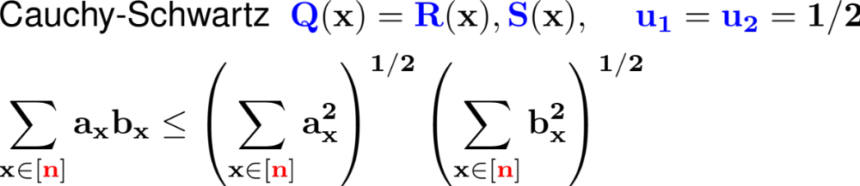
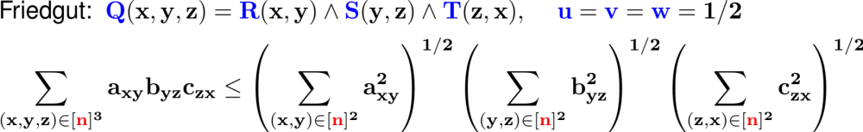
Background (2/2)
For any hypergraph Q and fractional edge cover u₁, u₂, ...
Theorem [Friedgut 2004]
Notes:
\mathbf{
\sum_{\bar x
\in
[{\color{red}n}]^k
}
a_{1,\bar x_1}
a_{2,\bar x_2}
\cdots
a_{\ell,\bar x_\ell}
\leq
}
& \mathbf{
\left(
\sum_{\bar x_1 \in [{\color{red}n}]^{k_1}} a_{1,{\bar x_1}}^{\frac{1}{\color{blue}u_1}}
\right)^{\color{blue}u_1}
\left(
\sum_{\bar x_2 \in [{\color{red}n}]^{k_2}} a_{2,{\bar x_2}}^{\frac{1}{\color{blue}u_2}}
\right)^{\color{blue}u_2}
\cdots
\left(
\sum_{\bar x_\ell \in [{\color{red}n}]^{k_\ell}} a_{\ell,{\bar x_\ell}}^{\frac{1}{\color{blue}u_\ell}}
\right)^{\color{blue}u_\ell}
}
----------------------------------------------------------------
&\mbox{Cauchy-Schwartz} \ \
\mathbf{
{\color{blue}Q}(x) = {\color{blue}R}(x),{\color{blue}S}(x),
}
\ \ \ \ \ \mathbf{
{\color{blue}u_1} = {\color{blue}u_2} = 1/2
} \\
&
\mathbf{
\sum_{x \in [{\color{red}n}]} a_{x} b_{x} \leq
\left(\sum_{x\in [{\color{red}n}]} a_{x}^2\right)^{1/2}
\left(\sum_{x\in [{\color{red}n}]} b_{x}^2\right)^{1/2}
}
----------------------------------------------------------------
&\mbox{Generalized H\"older} \ \
\mathbf{
{\color{blue}Q}(x) = {\color{blue}R}(x),{\color{blue}S}(x),{\color{blue}T}(x)
} \\
& \mathbf{
{\color{blue}u}+{\color{blue}v}+{\color{blue}w} \geq 1
} \\
&
\mathbf{
\sum_{x \in [{\color{red}n}]} a_{x} b_{x} c_{x} \leq
\left(\sum_{x \in [{\color{red}n}]} a_{x}^{1/{\color{blue}u}}\right)^{\color{blue}u}
\left(\sum_{x \in [{\color{red}n}]} b_{x}^{1/{\color{blue}v}}\right)^{\color{blue}v}
\left(\sum_{x \in [{\color{red}n}]} c_{x}^{1/{\color{blue}w}}\right)^{\color{blue}w}
}
----------------------------------------------------------------
&\mbox{Friedgut:} \ \
\mathbf{
{\color{blue}Q}(x,y,z) = {\color{blue}R}(x,y)\wedge{\color{blue}S}(y,z)\wedge{\color{blue}T}(z,x),
}
\ \ \ \ \ \mathbf{
{\color{blue}u} = {\color{blue}v} = {\color{blue}w} = 1/2
} \\
&
\mathbf{
\sum_{(x,y,z)\in [{\color{red}n}]^3} a_{xy} b_{yz} c_{zx} \leq
\left(\sum_{(x,y) \in [{\color{red}n}]^2} a_{xy}^2\right)^{1/2}
\left(\sum_{(y,z) \in [{\color{red}n}]^2} b_{yz}^2\right)^{1/2}
\left(\sum_{(z,x) \in [{\color{red}n}]^2} c_{zx}^2\right)^{1/2}
}

Slide 29
Step 3: Compute E[ |A_{u}| ]
Q(x,y,z) = R(x,y)∧S(y,z)∧T(z,x)
|R| = |S| = |T| = n tuples
Let A_{u} = {(i,j,k) | (i,j),(j,k), and (k,i) are certain}
Lemma. E[ |A_{u}| ] ≤ ( L / 3*log(n!) )^{3/2}
Friedgut
Proof Let a_{ij} = P( (i,j) ∈ K(msg₁(R))). Similarly b_{jk} , c_{ij} for S, T
E[ |A_{u}| ] = Σ_{ijk} a_{ij} b_{jk} c_{ij} ≤ (Σ_{ij} a_{ij}²)^{1/2} * (Σ_{jk} b_{jk}²)^{1/2} * (Σ_{ik} c_{ik}²)^{1/2}
≤ (L₁/log n! * L₂/log n! * L₃/log n!)^{1/2}
≤ ((L₁+L₂+L₃) / 3*log(n!) )^{3/2}
≤ (L /(3*log(n!) ))^{3/2}
Σ_{ij} a_{ij} = E[ |K(msg₁(R))| ] ≤
≤ H(msg₁(R))/H(R) * n = L₁ / log n! * n
a_{ij} ≤ 1/n
Σ_{ij} a_{ij}² ≤ L₁ / log n!
Theorem E[ |A| ] ≤ ( L / L_{lower})^{3/2} E[ |Q| ]
Proof E[ |A| ] = p E[ |A_{u}| ] ≤ ( L / (3 log n! / p^{2/3} ))^{3/2}
= ( L / L_{lower})^{3/2} E[ |Q| ]. QED.

Slide 30
Full Conjunctive Query
So far we discussed:
  Join L = m/p
  Triangles L = m/p^{2/3}
Next: full conjunctive queries

Slide 31
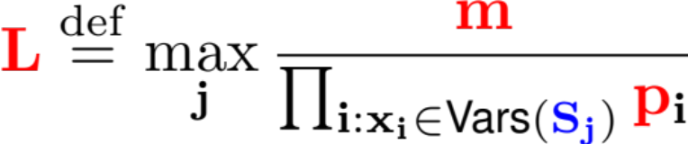
Full Conjunctive Query
HyperCube Algorithm:
Write: p = p₁ * p₂ * … * p_{k}
“shares“
Round 1: send S_{j}(x_{j1}, x_{j2}, …) to all servers
whose coordinates agree with h_{j1}(x_{j1}), h_{j2}(x_{j2}), …
Output: compute Q locally
Problem: Choose p₁ * p₂ * … * p_{k} to minimize
Notes:
Latexit:
\mathbf{
{\color{blue}Q}(x_1, \ldots, x_k) =
{\color{blue}S_1}(\bar x_1) \wedge
{\color{blue}S_2}(\bar x_2) \wedge \cdots \wedge
{\color{blue}S_\ell}(\bar x_\ell)
}
-----------------------------------------
\mathbf{
{\color{red}L} \stackrel{\mathrm{def}}{=} \max_j \frac{{\color{red}m}}{\prod_{i: x_i \in \text{Vars}({\color{blue}S_j})} {\color{red}p}_i}
}

Slide 32
Background
Hyper-graph: nodes x₁, …, x_{k}, edges S₁, …, S_{l}
Def.Fractional vertex cover v₁, v₂, … v_{k} ≥ 0 s.t.∀S_{j}: Σ_{i:xi∈Sj} v_{i} ≥ 1
Fractional edge packing u₁, u₂, … u_{l} ≥ 0 s.t.∀x_{i}: Σ_{j:xi∈Sj} u_{j} ≤ 1
min_{v1,… vk} Σ_{i} v_{i} = max_{u1,… ul} Σ_{j} u_{j} = τ*
Unrelated to ρ*

Slide 33
Optimal Shares
[Beame’13]
Thm. (1) Optimal shares for HyperCube: p_{i} = p^{vi* / τ*}
Optimal load: L = Ω(m/p^{1/τ*}) over db’s without skew
(2) Any 1-round algorithm has load Ω(m/p^{1/τ*})
even on inputs without skew.
½
τ* = 2
0
1
0
τ* = 3/2
0
1
0
1
0
½
½
τ* = 1
L = m / p
L = m / p^{2/3}
L = m / p^{1/2}
Notes:
Latexit:
\forall \mathbf{j: } \sum_{\mathbf{i: {\color[rgb]{0.000000,0.000000,1.000000}x_i} \in {\color[rgb]{0.000000,0.000000,1.000000}S_j}}} {\color[rgb]{0.000000,0.000000,0.000000}{\color[rgb]{0.000000,0.000000,1.000000}\mathbf{v_i}}}
\geq
\mathbf{{\color[rgb]{0.000000,0.000000,0.000000}1}}

Slide 34
Basic Processing: Summary
Load f(τ*), even w/o skew
 | One Round |  |  | r Rounds
 | No Skew |  | Skew
 | |S₁| = |S₂| = … = m | m₁, m₂,..
Algorithm | Join L = m/p Triang L = m/p^{2/3} CQ L = m/p^{1/τ*} | . . .
Lower Bound | Same as above | …
What if the input sizes |S₁|, |S₂|, |S₃|, … are not equal?

Slide 35
Unequal Inputs

Slide 36
Motivation
Cardinalities m₁, m₂, … are the simplest kind of data statistics
State of the art: even the simplest optimizers today use cardinalities
E.g.: R ⋈ S: if R << S, then broadcast R
What is the optimal load L = f(m₁, m₂, … )?

Slide 37
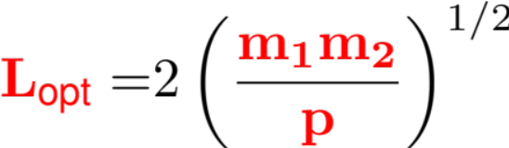

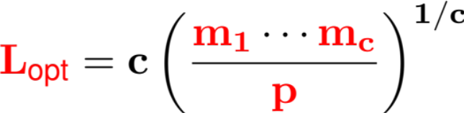
Warm up: Cartesian Product
Product(x,y) = R(x)∧S(y), |R| = m₁ |S| = m₂
 | 1 | 2 |  |  |  |  |  |  | p₂
1
2
p₁
Fact The optimal load is
.
R(x) →
1. Algorithm: p = p₁ × p₂
L = m₁ / p₁ + m₂ / p₂ ≥ 2 (m₁m₂ / p₁p₂)^{1/2}
Choose p₁, p₂ s.t. m₁ / p₁ = m₂ / p₂
2. Lower bound: any server with load L_{R} + L_{S} ≤ L computes at most
L_{R} * L_{S} ≤ ((L_{R} + L_{S})/2)^{1/2} ≤ (L/2)^{1/2} tuples; hence p*(L/2)^{1/2} ≥ m₁m₂
S(y) →
Fact. Any algorithm computing a cartesian product
has load .
Notes:
\mathbf{
{\color{red} p_1} = \left(\frac{{\color{red}m_1}}{{\color{red}m_2}}\cdot {\color{red}p}\right)^{1/2} \ \
{\color{red} p_2} = \left(\frac{{\color{red}m_2}}{{\color{red}m_1}}\cdot {\color{red}p}\right)^{1/2}
}
----------------------
\mathbf{
{\color{red}L_{\text{opt}}}
}
= & 2
\left(\frac{{\color{red}\mathbf{m_1 m_2}}}{{\color{red}\mathbf{p}}}\right)^{1/2}
----------------------
\mathbf{{\color{blue}S_1}(x_1)\wedge \cdots \wedge {\color{blue}S_c}(x_c)}
----------------------
\mathbf{{\color{red}L_\text{opt}} = c \left(\frac{{\color{red}m_1}\cdots{\color{red}m_c}}{{\color{red}p}}\right)^{1/c}}

Slide 38

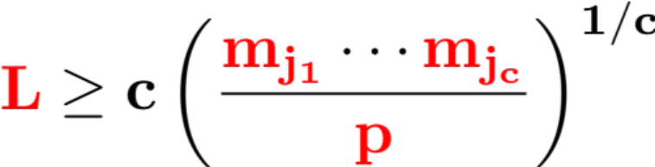

A Simple Lower Bound on L
Relations sizes= m₁, m₂, …
Definition. A packing is a subset of atoms that
do not share any variables.
Fact. For any packing, any 1-round algorithm
computing Q has load ,
even on non-skewed data.
Proof To compute Q, the algorithm must also compute
Notes:
\mathbf{
{\color{blue}Q}(x_1, \ldots, x_k) = {\color{blue}S_1}(\bar x_1) \wedge \cdots \wedge {\color{blue}S_\ell}(\bar x_\ell)
}
-----------------------
\mathbf{
{\color{blue}S_{j_1}}, \cdots {\color{blue}S_{j_c}}
}
----------------------
\mathbf{{\color{red}L} \geq c \left(\frac{{\color{red}m_{j_1}}\cdots{\color{red}m_{j_c}}}{{\color{red}p}}\right)^{1/c}}
-----------------------
\mathbf{
{\color{blue}S_{j_1}} \times \cdots \times {\color{blue}S_{j_c}}
}

Slide 39
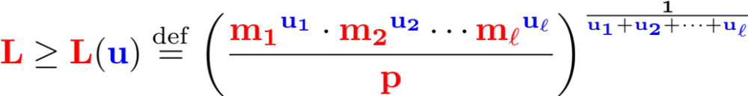
Optimal Load L
Relations sizes= m₁, m₂, …
[Beame’14]
Theorem (1) Fix a fractional edge packing u = (u₁, …, u_{l}).
Any 1-round algorithm for Q requires a load
even on inputs with no skew.
(2) There exists shares for the HyperCube algorithm
s.t. its load is max_{u} L(u) on databases without skew.
Notes:
Preamble:
\usepackage{helvet} \renewcommand{\familydefault}{\sfdefault}
----------------------------------
\mathbf{
{\color{blue}Q}(x_1, \ldots, x_k) = {\color{blue}S_1}(\bar x_1) \wedge \cdots {\color{blue}S_\ell}(\bar x_\ell)
}
----------------------------------
\mathbf{
{\color{red}L} \geq
{\color{red}L}({\color{blue}u})\stackrel{\mathrm{def}}{=}
\left(
\frac{
{\color{red}m_1}^{\color{blue}u_1}\cdot
{\color{red}m_2}^{\color{blue}u_2}\cdots
{\color{red}m_\ell}^{\color{blue}u_\ell}
}
{\color{red}p}
\right)^
{\frac{1}{{\color{blue}u_1} + {\color{blue}u_2} + \cdots + {\color{blue}u_\ell}}}
}

Slide 40
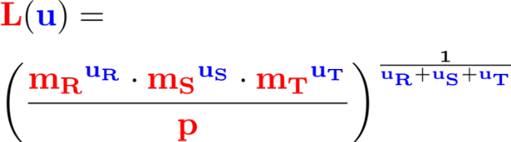

Example
½
½
1
0
Q(x,y,z) = R(x,y)∧S(y,z)∧T(z,x)
½
0
Vertex of edge packing polytope u_{R}, u_{S}, u_{T} |  | Max when ... | HC Algorithm
1/2, 1/2, 1/2
1, 0, 0
0, 1, 0
0, 0, 1
0, 0, 0
Notes:
& \mathbf{{\color{red}L}({\color{blue}u})=} \\
&
\mathbf{
\left(
\frac{
{{\color{red}m_R}}^{\color{blue}u_R} \cdot
{{\color{red}m_S}}^{\color{blue}u_S} \cdot
{{\color{red}m_T}}^{\color{blue}u_T}
}
{\color{red}p}
\right)^{
\frac{1}{{\color{blue}u_R}+{\color{blue}u_S}+{\color{blue}u_T}
}
}
}
=================================
\mathbf{
\frac{{\color{red}m}_R}{\color{red}p}
\geq
\sqrt{\frac{{\color{red}m}_S{\color{red}m}_T}
{\color{red}p}}
}
==================================
\mathbf{
{\color{red}p}^{\color{blue}e_x} \cdot {\color{red}p}^{\color{blue}e_y} \cdot {\color{red}p}^{\color{blue}e_z}
}

Slide 41
Example
½
½
1
0
Q(x,y,z) = R(x,y)∧S(y,z)∧T(z,x)
½
0
Vertex of edge packing polytope u_{R}, u_{S}, u_{T} |  | Max when ... | HC Algorithm
1/2, 1/2, 1/2 | (m_{R} m_{S} m_{T})^{1/3} / p^{2/3}
1, 0, 0 | m_{R} / p
0, 1, 0 | m_{S} / p
0, 0, 1 | m_{T} / p
0, 0, 0 | 0
L = max of these five values
Notes:
& \mathbf{{\color{red}L}({\color{blue}u})=} \\
&
\mathbf{
\left(
\frac{
{{\color{red}m_R}}^{\color{blue}u_R} \cdot
{{\color{red}m_S}}^{\color{blue}u_S} \cdot
{{\color{red}m_T}}^{\color{blue}u_T}
}
{\color{red}p}
\right)^{
\frac{1}{{\color{blue}u_R}+{\color{blue}u_S}+{\color{blue}u_T}
}
}
}
=================================
\mathbf{
\frac{{\color{red}m}_R}{\color{red}p}
\geq
\sqrt{\frac{{\color{red}m}_S{\color{red}m}_T}
{\color{red}p}}
}
==================================
\mathbf{
{\color{red}p}^{\color{blue}e_x} \cdot {\color{red}p}^{\color{blue}e_y} \cdot {\color{red}p}^{\color{blue}e_z}
}

Slide 42
Example
½
½
1
0
Q(x,y,z) = R(x,y)∧S(y,z)∧T(z,x)
½
0
Vertex of edge packing polytope u_{R}, u_{S}, u_{T} |  | Max when ... | HC Algorithm
1/2, 1/2, 1/2 | (m_{R} m_{S} m_{T})^{1/3} / p^{2/3}
1, 0, 0 | m_{R} / p
0, 1, 0 | m_{S} / p
0, 0, 1 | m_{T} / p
0, 0, 0 | 0 | never
L = max of these five values
Notes:
& \mathbf{{\color{red}L}({\color{blue}u})=} \\
&
\mathbf{
\left(
\frac{
{{\color{red}m_R}}^{\color{blue}u_R} \cdot
{{\color{red}m_S}}^{\color{blue}u_S} \cdot
{{\color{red}m_T}}^{\color{blue}u_T}
}
{\color{red}p}
\right)^{
\frac{1}{{\color{blue}u_R}+{\color{blue}u_S}+{\color{blue}u_T}
}
}
}
=================================
\mathbf{
\frac{{\color{red}m}_R}{\color{red}p}
\geq
\sqrt{\frac{{\color{red}m}_S{\color{red}m}_T}
{\color{red}p}}
}
==================================
\mathbf{
{\color{red}p}^{\color{blue}e_x} \cdot {\color{red}p}^{\color{blue}e_y} \cdot {\color{red}p}^{\color{blue}e_z}
}

Slide 43
Example
½
½
1
0
Q(x,y,z) = R(x,y)∧S(y,z)∧T(z,x)
½
0
Vertex of edge packing polytope u_{R}, u_{S}, u_{T} |  | Max when ... | HC Algorithm
1/2, 1/2, 1/2 | (m_{R} m_{S} m_{T})^{1/3} / p^{2/3} | m_{R} ≈ m_{S} ≈ m_{T} | e_{x}, e_{y}, e_{z} > 0
1, 0, 0 | m_{R} / p
0, 1, 0 | m_{S} / p
0, 0, 1 | m_{T} / p
0, 0, 0 | 0 | never
L = max of these five values
Notes:
& \mathbf{{\color{red}L}({\color{blue}u})=} \\
&
\mathbf{
\left(
\frac{
{{\color{red}m_R}}^{\color{blue}u_R} \cdot
{{\color{red}m_S}}^{\color{blue}u_S} \cdot
{{\color{red}m_T}}^{\color{blue}u_T}
}
{\color{red}p}
\right)^{
\frac{1}{{\color{blue}u_R}+{\color{blue}u_S}+{\color{blue}u_T}
}
}
}
=================================
\mathbf{
\frac{{\color{red}m}_R}{\color{red}p}
\geq
\sqrt{\frac{{\color{red}m}_S{\color{red}m}_T}
{\color{red}p}}
}
==================================
\mathbf{
{\color{red}p}^{\color{blue}e_x} \cdot {\color{red}p}^{\color{blue}e_y} \cdot {\color{red}p}^{\color{blue}e_z}
}

Slide 44
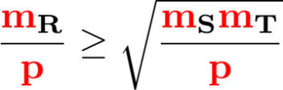
Example
½
½
1
0
Q(x,y,z) = R(x,y)∧S(y,z)∧T(z,x)
½
0
Vertex of edge packing polytope u_{R}, u_{S}, u_{T} |  | Max when ... | HC Algorithm
1/2, 1/2, 1/2 | (m_{R} m_{S} m_{T})^{1/3} / p^{2/3} | m_{R} ≈ m_{S} ≈ m_{T} | e_{x}, e_{y}, e_{z} > 0
1, 0, 0 | m_{R} / p |  | e_{z} = 0 join R with product S×T
0, 1, 0 | m_{S} / p | . . . | . . .
0, 0, 1 | m_{T} / p | . . . | . . .
0, 0, 0 | 0 | never
L = max of these five values
Notes:
& \mathbf{{\color{red}L}({\color{blue}u})=} \\
&
\mathbf{
\left(
\frac{
{{\color{red}m_R}}^{\color{blue}u_R} \cdot
{{\color{red}m_S}}^{\color{blue}u_S} \cdot
{{\color{red}m_T}}^{\color{blue}u_T}
}
{\color{red}p}
\right)^{
\frac{1}{{\color{blue}u_R}+{\color{blue}u_S}+{\color{blue}u_T}
}
}
}
=================================
\mathbf{
\frac{{\color{red}m}_R}{\color{red}p}
\geq
\sqrt{\frac{{\color{red}m}_S{\color{red}m}_T}
{\color{red}p}}
}
==================================
\mathbf{
{\color{red}p}^{\color{blue}e_x} \cdot {\color{red}p}^{\color{blue}e_y} \cdot {\color{red}p}^{\color{blue}e_z}
}

Slide 45
Example
½
½
1
0
Q(x,y,z) = R(x,y)∧S(y,z)∧T(z,x)
½
0
Vertex of edge packing polytope u_{R}, u_{S}, u_{T} |  | Max when ... | HC Algorithm
1/2, 1/2, 1/2 | (m_{R} m_{S} m_{T})^{1/3} / p^{2/3} | m_{R} ≈ m_{S} ≈ m_{T} | e_{x}, e_{y}, e_{z} > 0
1, 0, 0 | m_{R} / p |  | e_{z} = 0 join R with product S×T
0, 1, 0 | m_{S} / p | . . . | . . .
0, 0, 1 | m_{T} / p | . . . | . . .
0, 0, 0 | 0 | never
Better
speedup
L = max of these five values
Notes:
& \mathbf{{\color{red}L}({\color{blue}u})=} \\
&
\mathbf{
\left(
\frac{
{{\color{red}m_R}}^{\color{blue}u_R} \cdot
{{\color{red}m_S}}^{\color{blue}u_S} \cdot
{{\color{red}m_T}}^{\color{blue}u_T}
}
{\color{red}p}
\right)^{
\frac{1}{{\color{blue}u_R}+{\color{blue}u_S}+{\color{blue}u_T}
}
}
}
=================================
\mathbf{
\frac{{\color{red}m}_R}{\color{red}p}
\geq
\sqrt{\frac{{\color{red}m}_S{\color{red}m}_T}
{\color{red}p}}
}
==================================
\mathbf{
{\color{red}p}^{\color{blue}e_x} \cdot {\color{red}p}^{\color{blue}e_y} \cdot {\color{red}p}^{\color{blue}e_z}
}

Slide 46
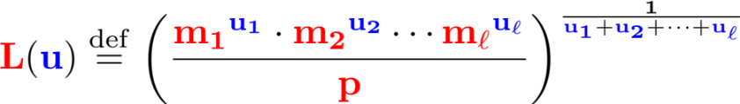

Discussion
Special case: m₁ = m₂ = … = m
Proof technique:
  Lower bound: holds for any solution of a primal LP
  Note: argmax L(u) = vertex u of edge packing polytope
  Upper bound: HC shares for any solution of a dual LP
  At optimality, they coincide, proving the load is optimal
Speedup
  Given by 1/p^{1/Σuj} ; better than 1/p^{1/τ*}
  As p increases, speedup degrades to 1/p^{1/τ*}
Speedup
p
Notes:
\mathbf{
{\color{red}L}({\color{blue}u})\stackrel{\mathrm{def}}{=}
\left(
\frac{
{\color{red}m_1}^{\color{blue}u_1}\cdot
{\color{red}m_2}^{\color{blue}u_2}\cdots
{\color{red}m_\ell}^{\color{blue}u_\ell}
}
{\color{red}p}
\right)^
{\frac{1}{{\color{blue}u_1} + {\color{blue}u_2} + \cdots + {\color{blue}u_\ell}}}
}
--------------------------
\mathbf{
{\color{red}L}({\color{blue}u})=
{\color{red}m}/{\color{red}p}^
{1/({\color{blue}u_1} + {\color{blue}u_2} + \cdots + {\color{blue}u_\ell})}
}
-----------------------
\mathbf{
\max_{\color{blue}u} {\color{red}L}({\color{blue}u})
=
{\color{red}m}/{\color{red}p}^{1/{\color{blue}\tau^*}}
}

Slide 47
Unequal Inputs: Summary
Load = max(vertices of
edge packing polytope)
 | One Round |  |  | ...
 | No Skew |  | Skew
 | |S₁| = |S₂| = … = m | m₁, m₂, …
Algo-rithm | Join L = m/p Triang L = m/p^{2/3} CQ L = m/p^{1/τ*} | L = max(m₁/p, m₂/p) L = max((m₁m₂m₃)^{1/3}/p^{2/3} , m₁/p, …) L = max_{u} L(u)
Lower Bound | Same as above | Same as above
So far we assumed no-skew. What if the data is skewed?

Slide 48
Skew

Slide 49
Skew Matters
Skewed data significantly degrades the performance in distributed query processing; skewed values must be treated specially
State of the art in large scale distributed system: DIY ☹

Slide 50
Skewed Values → Residual Query
Join(x,y,z) = R(x,y)∧S(y,z)
R(x,y) →
S(y,z) →
No-skew:
τ* = 1, L = m/p
Holds only when every y occurs ≤ m/p times
1 | 2 |  |  |  |  |  |  |  |  | p
 | 1 | 2 |  |  |  | p^{½}
1
2
p^{½}
Skewed: e.g. y = single value
Join becomes Product(x,z) = R(x)∧S(z)
τ* = 2, L = m/p^{1/2}
R(x) →
Skew necessarily leads to higher load
S(z) →

Slide 51
Residual-Query Algorithm
|S₁| = |S₂| = … = m
[Beame’16]
Def. A value is a heavy hitter if it occurs > m/p times
Def. Fix x ⊆{x₁, …, x_{k}}. The residual query Q_{x} is obtained
from Q by removing the variables x and the empty atoms.
Algorithm: In parallel, for every combination of heavy/light,
compute the residual query for that combination
Theorem. Let ψ*(Q) = max_{x} τ* (Q_{x})
(1) Load of the algorithm is: L = O(m/p^{1/ψ*})
(2) Any algorithm needs load L = Ω(m/p^{1/ψ*})

Slide 52
Example
Q(x,y,z) = R(x,y)∧S(y,z)∧T(z,x)
Heavy hitter = a value that occurs at least m/p times
Each attribute has at most p heavy hitters
x | y | z | Residual query | τ* | L | p₁ × p₂ × p₃
light | light | light | R(x,y)∧S(y,z)∧T(z,x) | 3/2 | m/p^{2/3} | p^{1/3} × p^{1/3} × p^{1/3}
. . . . |  |  | . . .

Slide 53
Example
Q(x,y,z) = R(x,y)∧S(y,z)∧T(z,x)
Heavy hitter = a value that occurs at least m/p times
Each attribute has at most p heavy hitters
x | y | z | Residual query | τ* | L | p₁ × p₂ × p₃
light | light | light | R(x,y)∧S(y,z)∧T(z,x) | 3/2 | m/p^{2/3} | p^{1/3} × p^{1/3} × p^{1/3}
light | light | heavy | R(x,y)∧S(y)∧T(x) | 2 | m/p^{1/2} | p^{1/2} × p^{1/2} × 1
. . . . |  |  | . . .

Slide 54
Example
Q(x,y,z) = R(x,y)∧S(y,z)∧T(z,x)
Heavy hitter = a value that occurs at least m/p times
Each attribute has at most p heavy hitters
x | y | z | Residual query | τ* | L | p₁ × p₂ × p₃
light | light | light | R(x,y)∧S(y,z)∧T(z,x) | 3/2 | m/p^{2/3} | p^{1/3} × p^{1/3} × p^{1/3}
light | light | heavy | R(x,y)∧S(y)∧T(x) | 2 | m/p^{1/2} | p^{1/2} × p^{1/2} × 1
light | heavy | heavy | R(x)∧T(x) | 1 | m/p | p × 1 × 1
. . . . |  |  | . . .
Broadcast S(y,z)
OK because |S| ≤ p²

Slide 55
Skew: Summary
Necessarily worse load
 | 1 Round |  |  | r Rounds
 | No Skew |  | Skew
 | |S₁| = |S₂| = … = m | m₁, m₂, … | |S₁| = |S₂| = … = m
Algo-rithm | Join: L = m/p Triangles: L = m/p^{2/3} Multi-join: L = m/p^{1/τ*} | . . . | L = m/p^{1/2} L = m/p^{1/2} L = m/p^{1/ψ*}
Lower Bound | Same as above |  | Same as above
So far we have considered only one round. What about multiple rounds?

Slide 56
Multiple Rounds

Slide 57
Multiple Rounds
Complex data analytics tasks requires multiple rounds
State of the art: each operator in a query plan is a separate round
Theoretical results are limited
  No skew: difficult theoretical analysis
  Skewed data: optimality for some queries

Slide 58
Background: AGM Bound
|S₁| = |S₂| = … = m
Theorem [Atserias, Grohe, Marx]
For any input database, |Q(DB)| ≤ m^{ρ*},
There exists a “worst case” database s.t. |Q(DB)| = m^{ρ*}
Proof will illustrate on Q(x,y,z) = R(x,y)∧S(y,z)∧T(z,x)
Let a_{ij} = 1 if (i,j) ∈R, a_{ij} = 0 otherwise; similarly b_{jk}, c_{ki}.
|Q| = Σ_{ijk} a_{ij} b_{jk}, c_{ki} ≤ (Σ_{ij} a_{ij}²)^{1/2} (Σ_{jk} b_{jk}²)^{1/2} (Σ_{ik} c_{ik}²)^{1/2}
= (|R| |S| |T|)^{1/2} = m^{3/2}
Use the vertex packing (½, ½, ½). Worst case db:
R = [m^{1/2}] × [m^{1/2}], S = [m^{1/2}] × [m^{1/2}], T = [m^{1/2}] × [m^{1/2}]
Note: worst case db is “skewed”

Slide 59
A General Lower Bound
|S₁| = |S₂| = … = m
[Beame’16]
Corollary Any algorithm for Q, with r rounds and load L,
satisfies: L ≥ m / (r×p^{1/ρ*}) = Ω(m / p^{1/ρ*})
Proof (informal):
Let DB be the “worst case” instance: |Q(DB)| = m^{ρ*}
After r rounds, a server is certain of a subset |S_{j}| ≤ r×L
By the AGM upper bound, it can output ≤ (r×L)^{ρ*} answers.
All p servers output p×(r×L)^{ρ*} ≥ m^{ρ*} answers.
Since there is no “worst case” instance for all algorithms,
consider a set of instances close to worst case

Slide 60
Discussion
1 round: load ≥ m / p^{1/τ*}, even w/o skew
r rounds: load ≥ m / r*p^{1/ρ*}, due to skew
For graphs: τ* ≤ ρ*;
For cycles (e.g. triangle): τ*=ρ*
For hypergraphs: no relationship τ*, ρ*
(See Bas Ketsman’s talk later today!)

Slide 61
Multiround: Summary
Load f(ρ*), due to skew
 | One Round |  |  |  | #Rounds = r
 | No Skew |  | Skew |  | Skew
 | |S₁| = |S₂| = … | m₁, m₂,.. | |S₁| = |S₂| … | m₁,m₂,.. | S₁| = |S₂| …
Algo-rithm | Join L = m/p Triang L = m/p^{2/3} Multi L = m/p^{1/τ*} | . . . | L = m/p^{1/2} L = m/p^{1/2} L = m/p^{1/ψ*} | similar... | L = m/p^{1/2} r = 1 L = m/p^{2/3} r = 2 L = ? (open)
Lower Bound | Same as above | … | Same as above |  | L ≥ m/p^{1/ρ*} * 1/r optimal?

Slide 62
Outline
Load f(τ*), even w/o skew
Basic Query Processing.
Non-uniform cardinalities
Skew
Multiple rounds
Open Problems
Load: max over
edge packing polytope
Necessarily worse load
Load f(ρ*), due to skew

Slide 63
Open Problem 1
Prove any lower bound for a Boolean query
E.g. Prove that any 1-round algorithm requires a load L ≥ m / p^{2/3} to compute
Q() = ∃x∃y∃z R(x,y)∧S(y,z)∧T(z,x)

Slide 64
Open Problem 2
What is the optimal load to compute Q on any (skewed) db, in any # of rounds?
Can’t be m / p^{1/τ*}
If it is m / p^{1/ρ*} then we need new algorithms for the light hitters when τ* ≥ ρ*
If it is something else, it needs to specialize to m / p^{1/ρ*} when the hypergraph is a graph

Slide 65
Open Problem 3
Restrict the input db to permutations
What is the optimal load to compute Q in r rounds?
Warmup: compute the chain of length 9, S₁(x₀, x₁)∧S₂(x₁, x₂)∧ …∧S₉(x₈, x₉)
in 2 rounds with L = m / p^{1/2}

Slide 66
Open Problem 4
Restrict the input db to random permutations
As a warmup, show:
  Any 1-round algo. requires L ≥ m / p^{1/2} for a 3-chain
  S₁(x₀, x₁)∧S₂(x₁, x₂)∧S₃(x₂, x₃)
  Compute a 4-chain in 2-rounds with L = m / p
  S₁(x₀, x₁)∧S₂(x₁, x₂)∧S₃(x₂, x₃)∧S₄(x₃, x₄)
Open: a 2-round algo. requires L ≥ m / p^{1/2} for a 5-chain
S₁(x₀, x₁)∧S₂(x₁, x₂)∧S₃(x₂, x₃)∧S₄(x₃, x₄)∧S₅(x₄, x₅)

Slide 67
Open Problem 5
Database: all heavy hitter degrees are known.
Design degree-optimal algorithms
As a warmup, consider a join R(x,y)∧S(y,z)
  Degrees of hh y in R: d₁, d₂, …
  Degrees of hh y in S: e₁, e₂, …
  Compute it in 1 round with L = m/p + (Σ_{i} d_{i} e_{i} / p)^{1/2}
Open: 1-round algorithm for any full CQ Q that is optimal given the hh degrees

Slide 68
Thank You!

